Slide 1

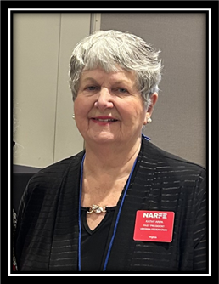

“ENHANCING YOUR CHAPTER NEWSLETTER FOR ELECTRONIC DISTRIBUTION”
Presented by:
Kathy Arpa, VFN Past President, VFN Membership Chair and President & Newsletter Editor, Chapter 1116 (Vienna-Oakton) - NARFE Life Member
August 6, 2025

Slide 2
WHAT OFFICERS ARE NECESSARY TO HAVE A NARFE CHAPTER?
There must be a President and Secretary. Many Chapters have members doing multiple jobs. For example, vice president and legislation.
One position that is equally important is the Newsletter Editor.

Slide 3
TODAY WE WILL DISCUSS THE IMPORTANCE OF CHAPTER NEWSLETTERS. WE WILL SHOW YOU EXAMPLES OF NEWSLETTERS THAT ARE ON THE VFN WEBSITE.
THE POWERPOINT PRESENTATION WILL BE AVAILABLE AFTER THE MEETING BY CONTACTING ELLIE LONG AT lalaw1986@gmail.com

Slide 4



Benefits of Chapter Newsletters
An opportunity for sharing chapter news.
A source of communication among, and with members and potential members.

Slide 5
DOES YOUR CHAPTER CURRENTLY DO A NEWSLETTER?
Some chapters have newsletters on the VFN Website dated 2024 and even 2023.

Slide 6
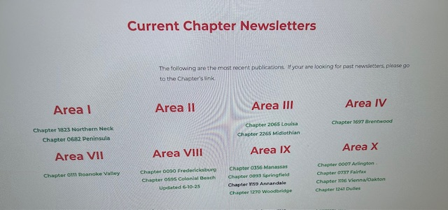

Slide 7

How often should a chapter publish its newsletter?
Some chapters publish one newsletter each quarter, others publish monthly – but keep them to four pages or less. ◦ This allows for continual communication with members but does not overwork the editorial staff. If you have a lot to report including pictures from a chapter event, you can expand the newsletter to six or eight pages and post it on the VFN website or use the FedHub community for distribution. Good examples of newsletters are Chapter 7 (Arlington), Chapter 0111 (Roanoke), Chapter 1697 Brentwood and Chapter 2265 Midlothian (very detailed) Ellie Long will now show you these four newsletters on the VFN website.
◦

Slide 8
What must a chapter have to begin a newsletter?
Newsletter Team
For Chapter 1116 – Kathy Arpa, Editor
Dave Graf – Co-editor (optional)

Slide 9
The editor’s primary job is to oversee the contents and publication of the newsletter. • The editor sees that articles are submitted and that the newsletter reflects the purposes and goals of the chapter and the newsletter itself. • The editor works with the board members to set and maintain guidelines, seeks out articles and ideas, and coordinates the final product.
The co-editor is responsible for reading submitted articles for grammatical, punctuation, and style errors. ◦ Someone with a strong background in English works well in this position and someone who has experience in programs such as Microsoft Word.
Since most chapters have gained new members this might be a way to get them involved this fall. It has been proven that members are more likely to attend a chapter meeting if they are involved in the chapter in some way. If you have a photographer in your chapter, you may ask him or her to take pictures periodically.

Slide 10
You finished your newsletter. Where do you send your electronic newsletter for posting on the VFN Website?

Slide 11
Chapters in Areas I and VII should email their
newsletter to Ellie Long at lalaw1986@gmail.com
Chapters in the remaining Areas should email their
newsletter to Stan Palen at stan@vanarfe.org
Area VIII has been eliminated. Chapter 90 Fredericksburg and Chapter 1549 are now part of Area IX. Chapter 1549 Colonial Beach and Chapter 2112 Caroline are now part of Area III. See next page for names of Area Vice Presidents.
In your email, state that you want it posted and indicate your chapter name and number.
.

Slide 12
VFN Area Vice Presidents
Riddle | Marilyn |  | AREA OFFICER 1
Warren | Betty L |  | AREA OFFICER 2
Graunke | Cynthia | (Cindy) | AREA OFFICER 3
Taylor | Graylin |  | AREA OFFICER 4
Greene | Ruth T |  | AREA OFFICER 7
Campbell | Carol |  | AREA OFFICER 9
Pasek | Theodore | (Ted) | AREA OFFICER 10

Slide 13
Other options for Distribution of Electronic Newsletter
Email – using your own database
NEW - FedHub – using chapter community. Must be set up by NARFE headquarters. Only goes to members on NARFE’s email listing.

Slide 14
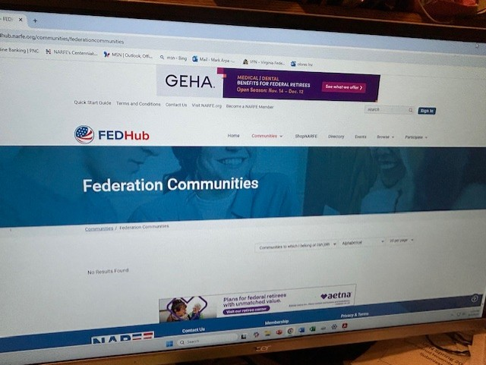
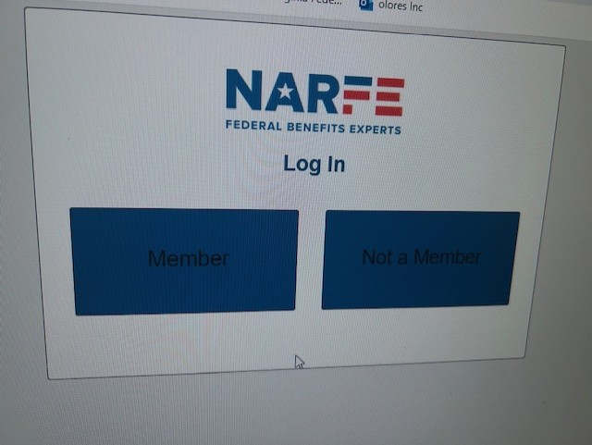
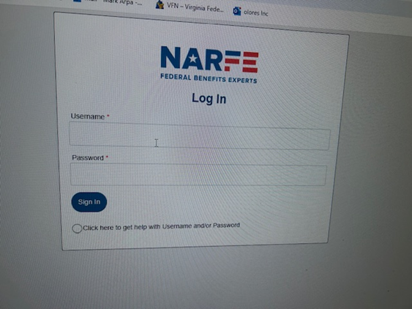
Go to www.narfe.org
Log in as member. If you don’t have a password for the NARFE website, you must create one.
Use your log in and password. Go to “Suggested communities”. Scroll down to NARFE Newsletter Exchange.

Slide 15
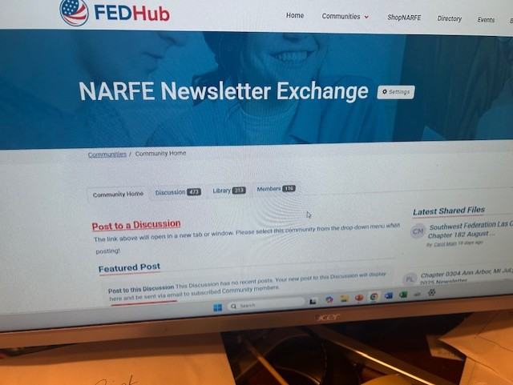
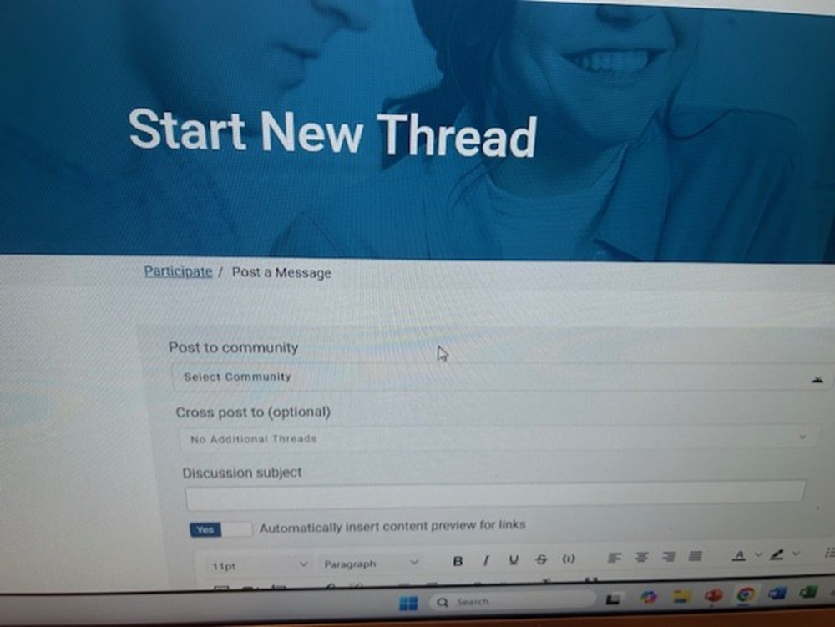
This is the screen where you will post your message.

Slide 16
What are common features in chapter newsletters?
Name of Chapter, Date and Location of Next Meeting
President’s column/message
Secretary’s report on last chapter meeting
Treasurer’s report
Program Details/Meeting Announcement) Upcoming Events (see next page)
Committee reports: (Alzheimer’s, legislation, membership, etc. (optional)
Photos
Listing of New Members. Names of deceased members.
Recognition of Members (years as a member), etc.
Sunshine report/birthdays (optional)
News from NARFE headquarters (optional)

Slide 17
COMING UP
COMING UP
September 9, 2025 – Chapter 1116 (Vienna-Oakton) Chapter Meeting – 1 PM. Vienna Community Center (VCC), 120 Cherry Street, SE, Vienna, VA 22180 – Guest speaker – Linda Colbert, Mayor of Vienna. For info, call Chapter President Kathy Arpa at 703-205-9041.
October 14 – Chapter Meeting – 1 PM. - VCC, Guest speaker - VFN President Deborah Fisk
November 11 – Chapter Meeting – 1 PM. – VCC – Guest speaker – Michele Johnson, Blue Cross and Blue Shield representative
December 9 – Holiday Party. Look for details in November Newsletter.

Slide 18
Feature the activities and accomplishments of your members.
Members will be more likely to read the newsletter after they have seen their name featured.

Slide 19
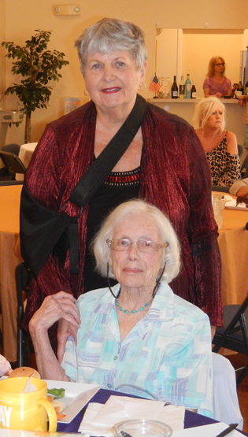
NARFE CHAPTER 1116 MEMBER CELEBRATES 100th BIRTHDAY
Shirley Martin celebrated her 100th birthday on July 12 with family and friends. Kathy Arpa, Chapter President, presented her with a letter signed by National President Bill Shackelford congratulating her on her 100th birthday.

Slide 20
Graphics are important!
Photographs and clipart make the newsletter more pleasing to the eye.
Solid pages of reading tend to be overlooked.
Do you want pictures in color or black and white? See samples on next pages.

Slide 21


Color vs. black & white

Slide 22
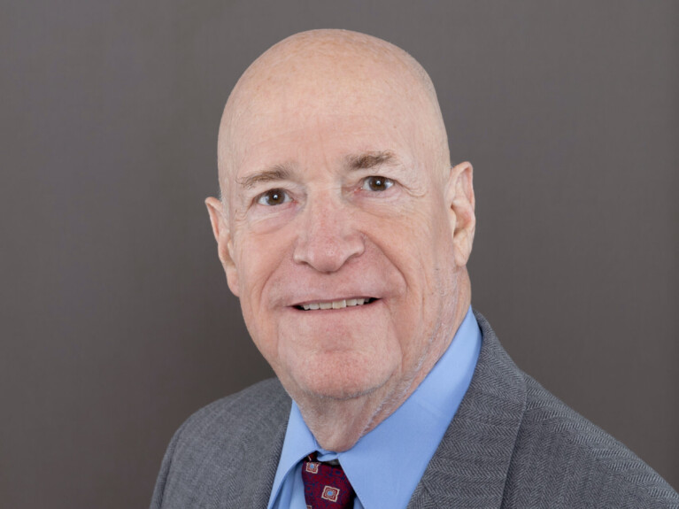
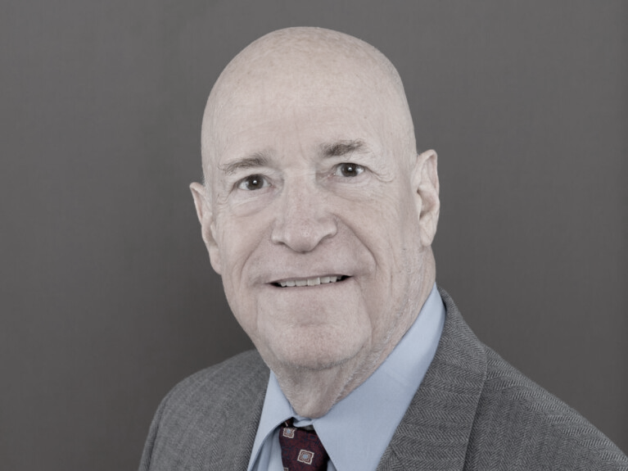
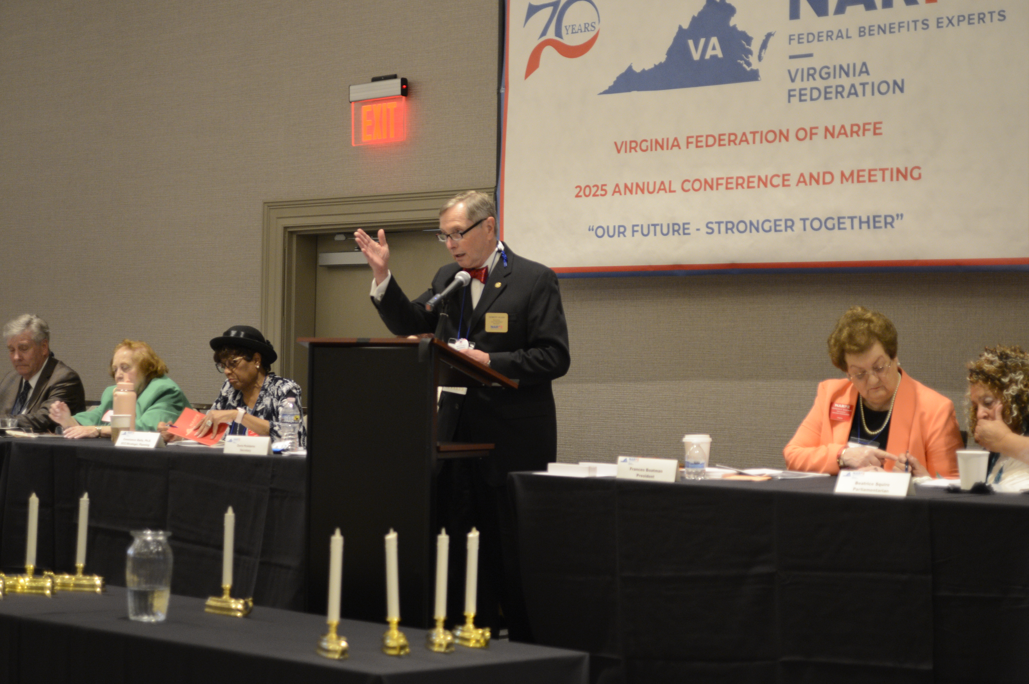
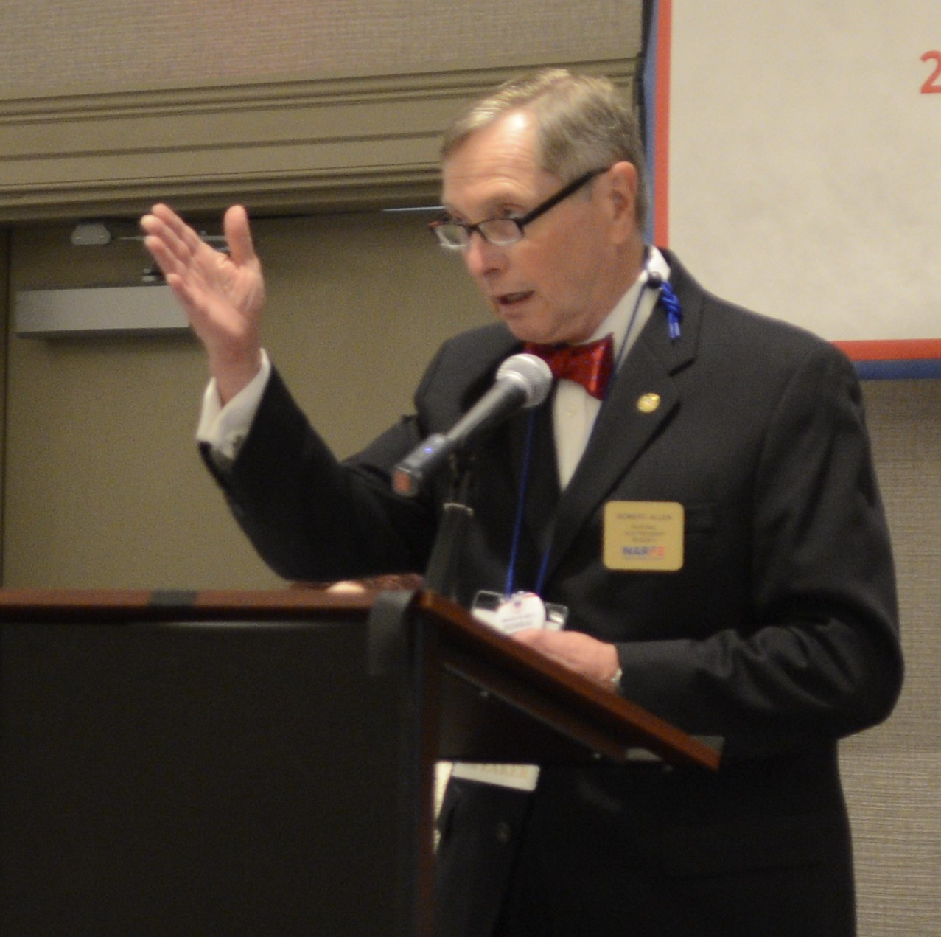
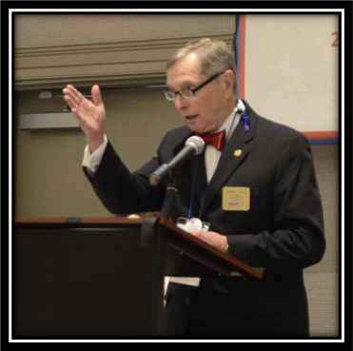
Bill Shackelford, NARFE President
Robert Allen, Region X Vice President

Slide 23


If you are planning to have the newsletter printed for mailing, be aware that graphics and pictures in color do not print well in black and white.
It is better to make two versions of the newsletter and mail the one with black and white graphics and make one with graphics in color to send on FEDHub, email or post on the VFN website.

Slide 24
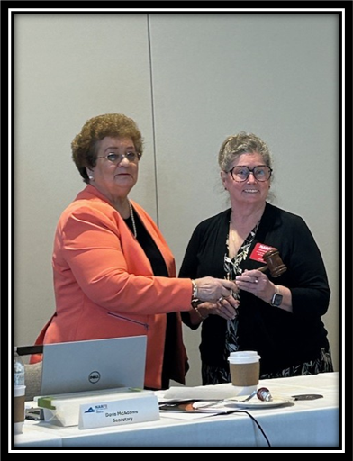
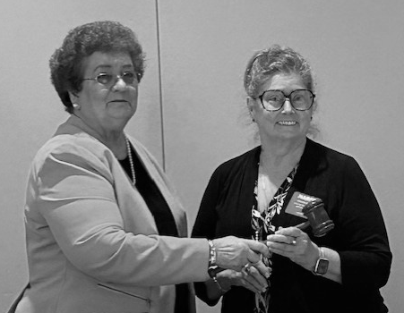
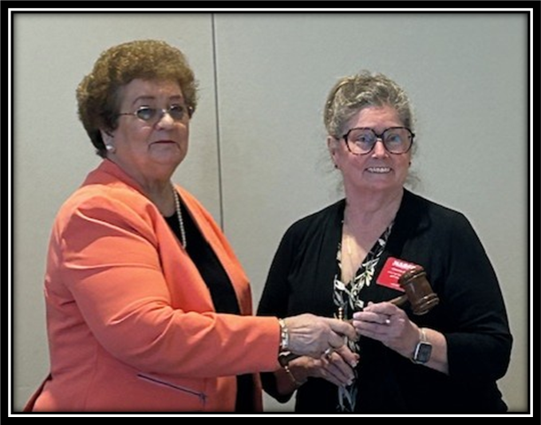
Passing the gavel
Frances Boatman to new VFN President Debbie Fisk – July 28, 2025
Cropped in color. See the difference.

Slide 25
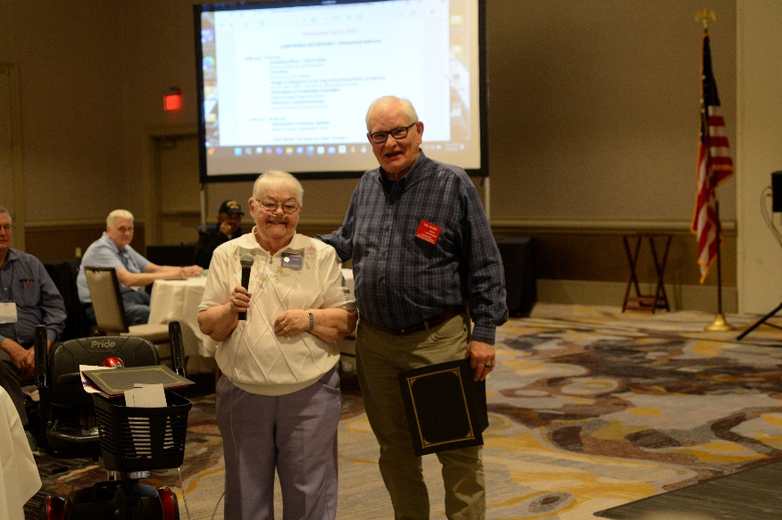

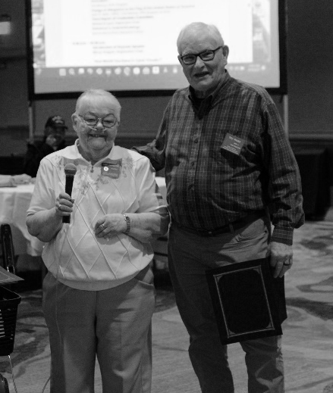
Donna Shackelford and Ted Pasek
Cropped in color Cropped in black and white

Slide 26
I WILL NOW SHOW YOU HOW TO CROP PICTURES (WORD DOCUMENT)

Slide 27


Reminders and Deadlines
Example:
August 10 • Resend reminder note to those submitting with deadline restated
August 20 – Deadline for articles to Editor
August 25 • Newsletter proofed, edited, and ready to go to print
August 26 – Newsletter mailed to members not on email (optional)
August 30 – Newsletter posted to VFN website and/or distributed via FedHub Community.

Slide 28
IMPORTANT NARFE WEBSITES
F.Y.I.
NARFE Headquarters www.narfe.org
Virginia Federation of NARFE www.vanarfe.org
SAVE FILES PERIODICALLY ON A SSD CARD. If your computer crashes or gets hacked, you can retrieve your old files. This is a message from Stan Palen, VFN Webmaster.

Slide 29

Special thanks to Ellie Long and Nancy Palmerino for their assistance in this presentation.

Slide 30
THANK YOU AGAIN FOR ATTENDING THIS PRESENTATION.

Slide 31

ARE THERE ANY QUESTIONS?

