Slide 1
VFNARFE
Electronics Communication Committee
Training:
Zoom Workplace
For
Beginners
Navigation Menu Bar
Wednesday June 4, 2025 2:00 PM

Slide 2
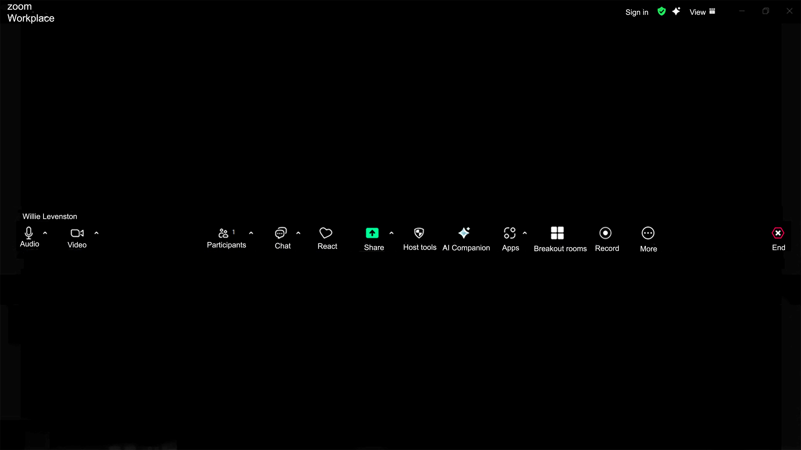
Sign in
View
Zoom Workplace
AI Companion
Restore Down
Meeting Information
Navigation Menu Bar
(Zoom app toolbar / in-meeting toolbar)
Microphone
Participants
React
AI Companion
Breakout Room
Camera
Record
Microphone Caret
Chat
Host Tools
Apps
Camera Caret
Participants Caret
Share
More
End
Chat Caret
Share Caret
Apps Caret

Slide 3
Microphone On

Slide 4
Microphone Off

Slide 5
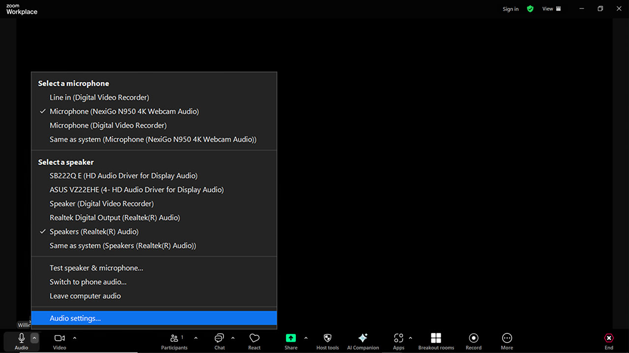
Audio Caret Menu

Slide 6
Audio Caret Menu
“Audio Settings”

Slide 7
Audio Caret Menu
“Audio Settings”

Slide 8
Camera Off

Slide 9
Camera On

Slide 10
Camera Caret Menu

Slide 11
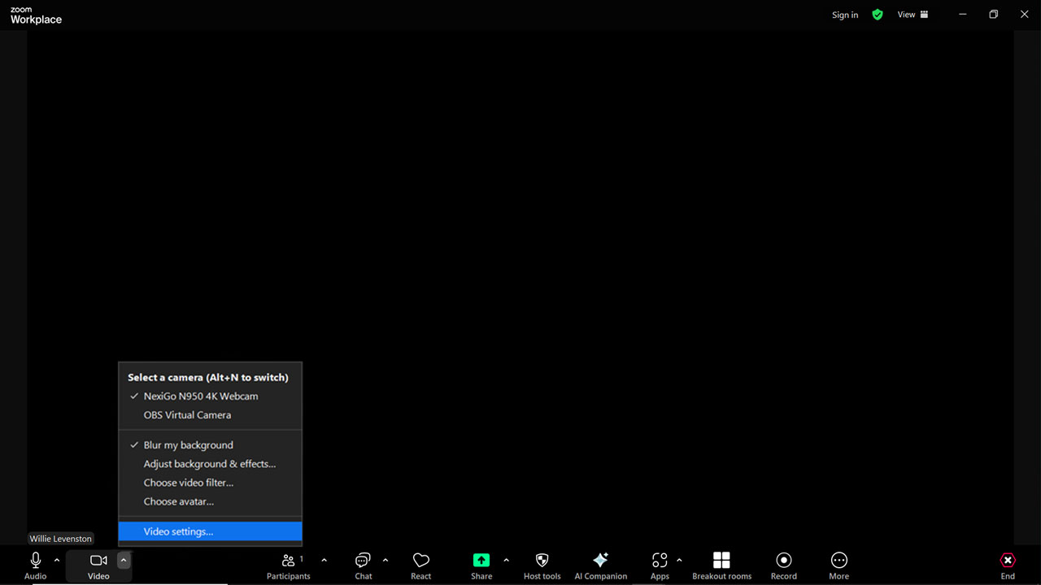
Camera Caret

Slide 12
Video Settings Menu
Video

Slide 13
Video Settings Menu
Video
Camera

Slide 14
Video Settings Menu
Video
Camera

Slide 15
Video Settings Menu
Video
Camera

Slide 16
Video Settings Menu
Video Settings Menu
Audio
Camera

Slide 17
Video Settings Menu
Audio
Camera

Slide 18
Video Settings Menu
Audio
Camera

Slide 19
Video Settings Menu
Share screen
Camera

Slide 20
Video Settings Menu
Share screen
Camera

Slide 21
Video Settings Menu
Share screen
Camera

Slide 22
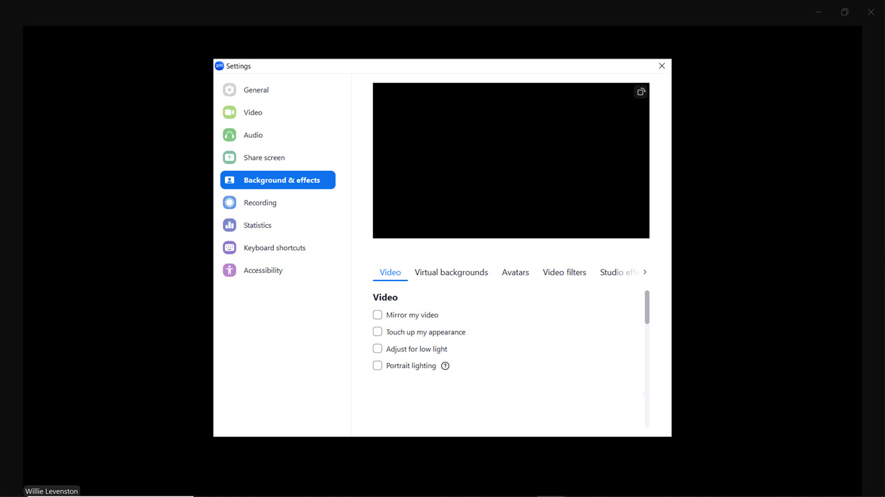
Video Settings Menu
Background & effects
Camera

Slide 23
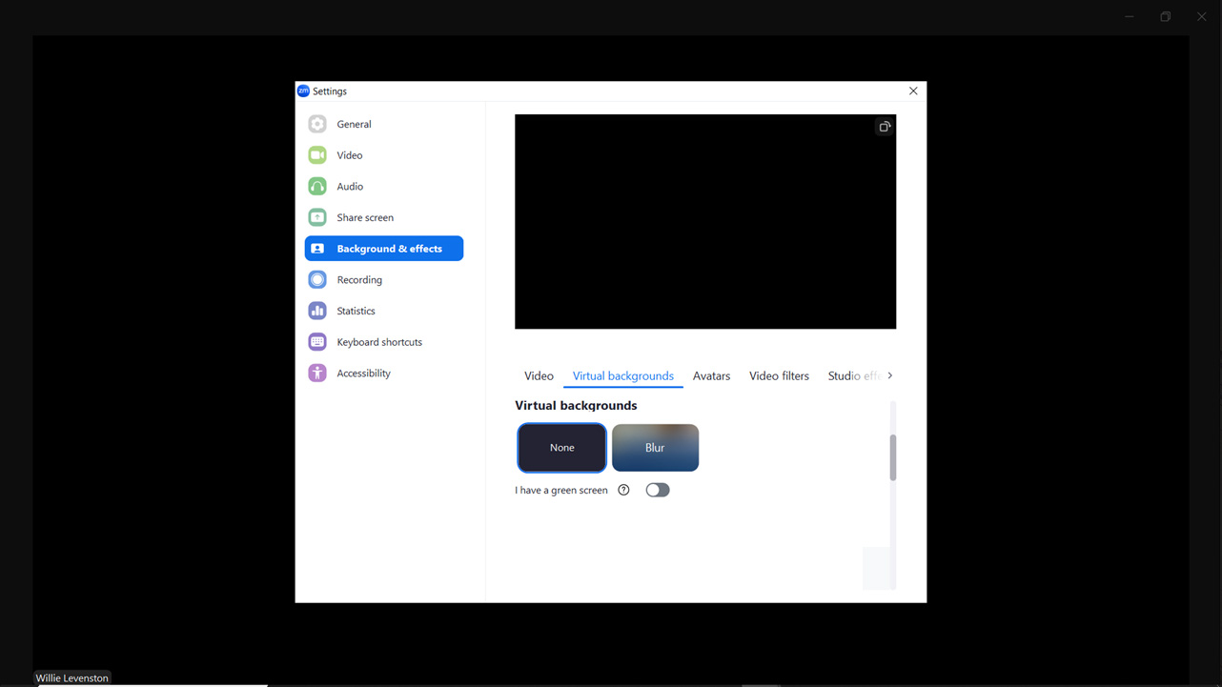
Video Settings Menu
Background & effects
Camera

Slide 24
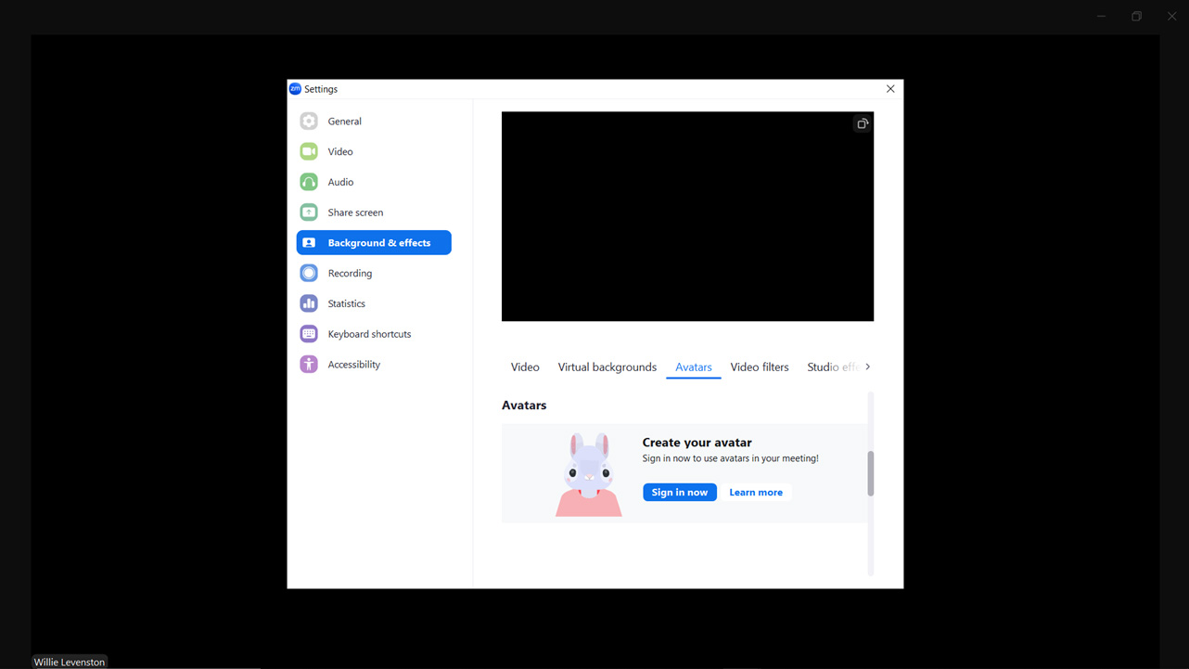
Video Settings Menu
Background & effects
Camera

Slide 25
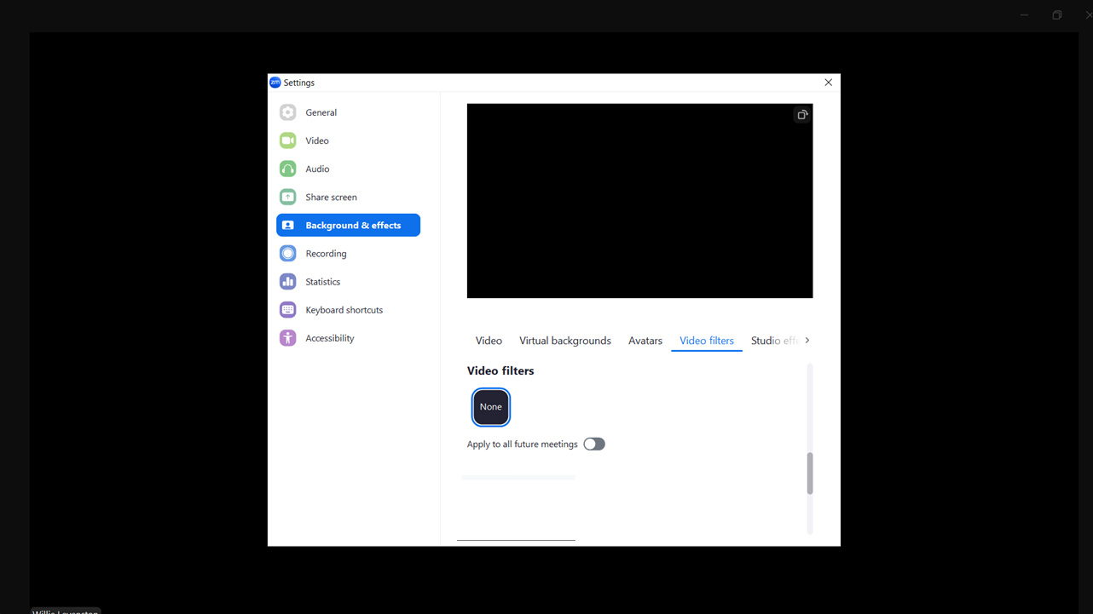
Video Settings Menu
Background & effects
Camera

Slide 26
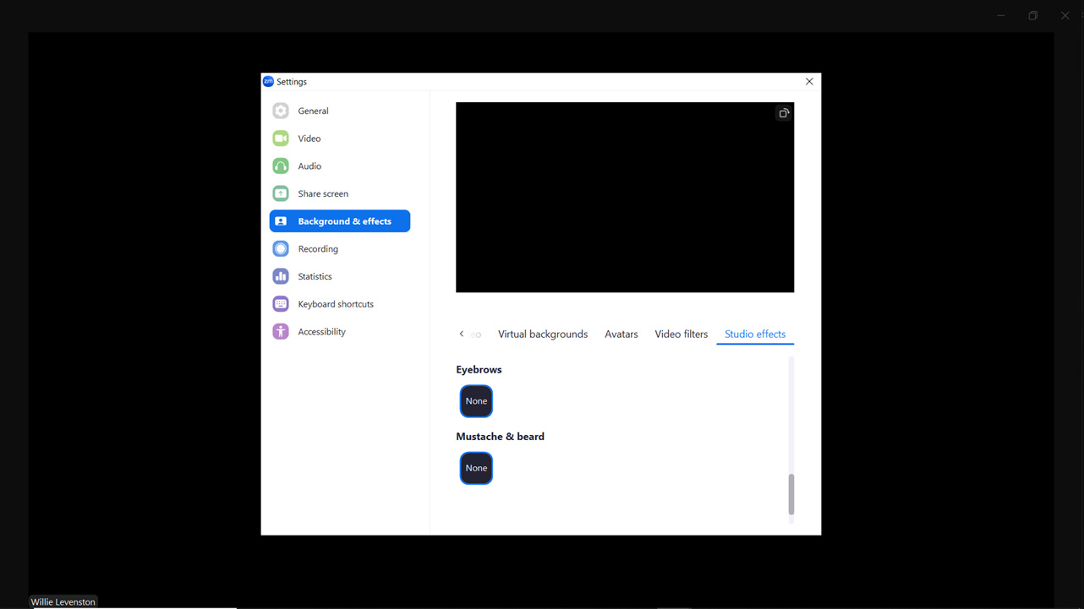
Video Settings Menu
Background & effects
Camera

Slide 27
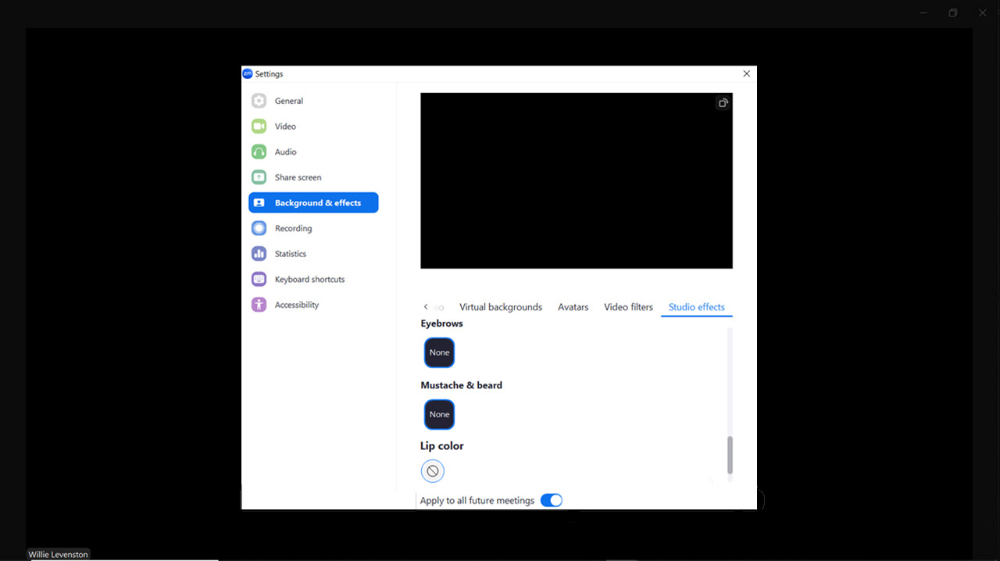
Video Settings Menu
Background & effects
Camera

Slide 28
Video Settings Menu
Recording
Camera

Slide 29
Video Settings Menu
Statistics
Camera

Slide 30
Video Settings Menu
Keyboard shortcuts
Camera

Slide 31
Video Settings Menu
Keyboard shortcuts
Camera

Slide 32
Video Settings Menu
Keyboard shortcuts
Camera

Slide 33
Video Settings Menu
Keyboard shortcuts
Camera

Slide 34
Video Settings Menu
Keyboard shortcuts
Camera

Slide 35
Video Settings Menu
Keyboard shortcuts
Camera

Slide 36
Video Settings Menu
Keyboard shortcuts
Camera

Slide 37
Video Settings Menu
Accessibility
Camera

Slide 38
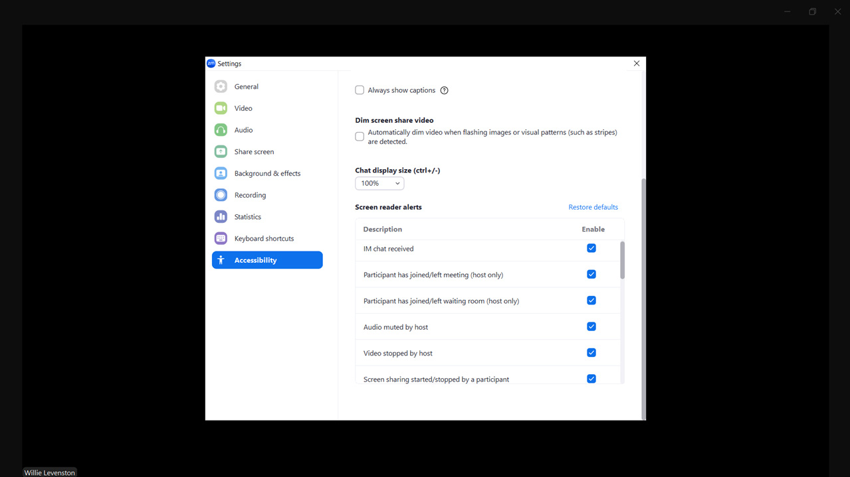
Video Settings Menu
Accessibility
Camera

Slide 39
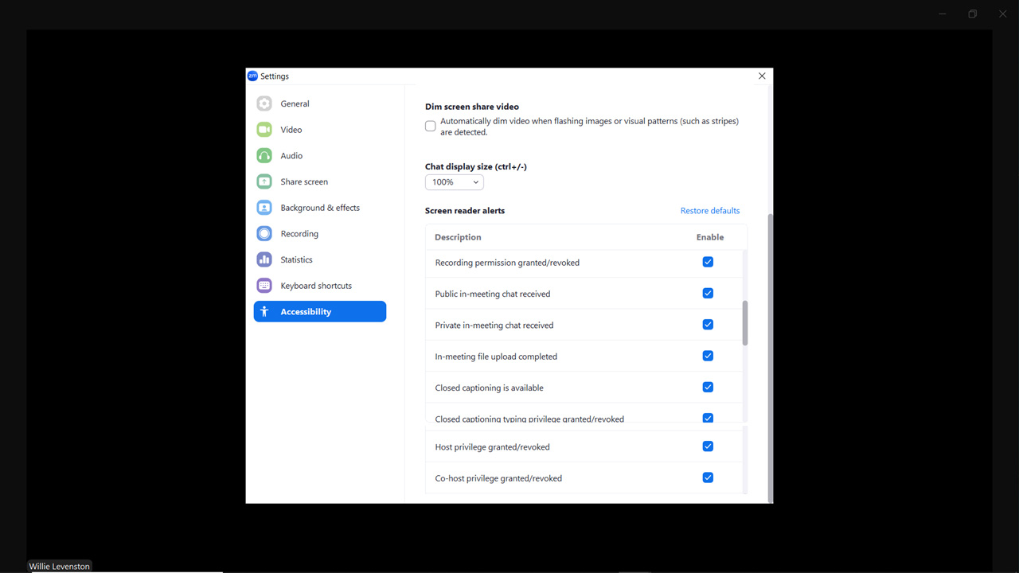
Video Settings Menu
Accessibility
Camera

Slide 40
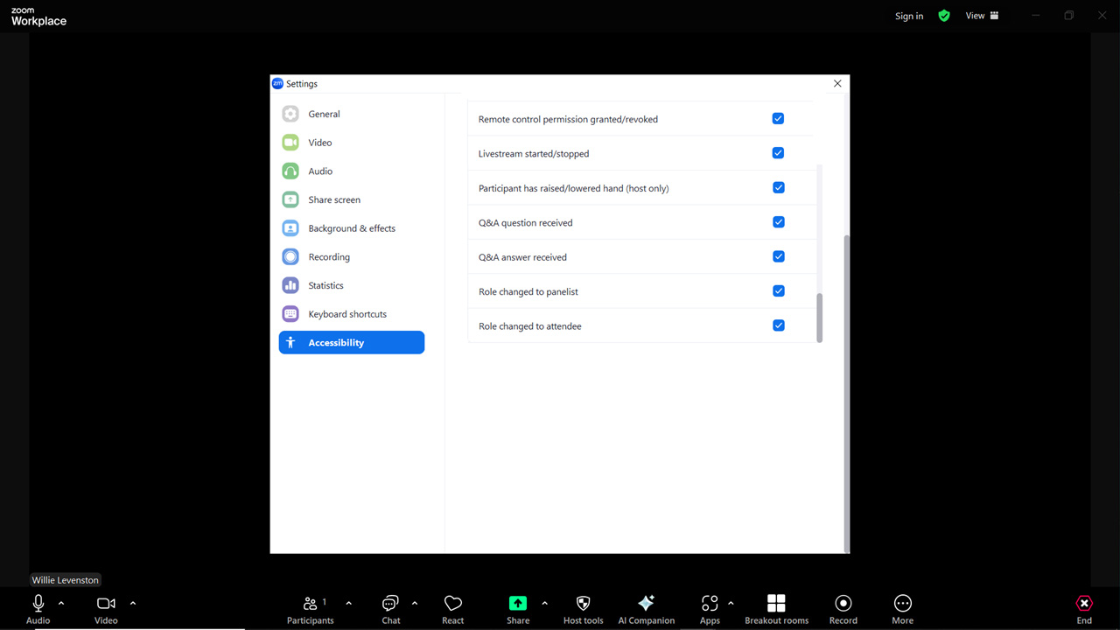
Video Settings Menu
Accessibility
Camera

Slide 41
Participants

Slide 42
Participants Window
Participants

Slide 43
Participants Caret Menu

Slide 44
Participants

Slide 45
Participants

Slide 46
Participants

Slide 47
Participants

Slide 49
Participants

Slide 51
Participants

Slide 52
Participants

Slide 53
More
Participants

Slide 54
Participants Window
Participants

Slide 55
Chat

Slide 56
Chat Caret

Slide 57
Chat Window

Slide 58
Chat Window
Format

Slide 59
Chat Window
Emoji

Slide 61
Chat Window
File

Slide 63
Chat
File
File

Slide 64
Chat
Screenshot

Slide 65
Screenshot Caret

Slide 66
Chat Window
Hide Chat Window in Screenshot

Slide 67
Hide chat window in screenshot

Slide 68
React

Slide 70
Share

Slide 71
React

Slide 72
Share Caret

Slide 73
Share Caret Menu

Slide 74
Host Tools

Slide 75
Host tools menu

Slide 76
AI Companion

Slide 77
AI Companion Window

Slide 78
AI Companion Settings
AI Companion Window

Slide 80
Apps

Slide 81
Apps Caret Menu

Slide 82
Breakout Room

Slide 83
Apps Caret options

Slide 85
Record

Slide 87
More

Slide 89
Captures

Slide 90
Polls/quizzes

Slide 91
Docs

Slide 92
Notes

Slide 93
Whiteboard

Slide 94
Livestream

Slide 95
Start focus

Slide 97
End

Slide 100
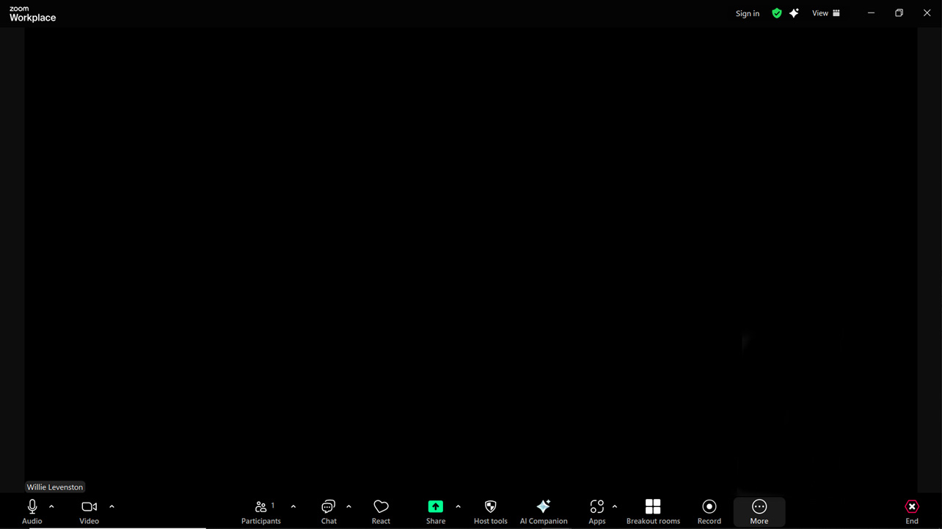
Meeting Information
Meeting Information
End

Slide 102
AI Companion
AI Companion
End

Slide 104
View
AI Companion
End

Slide 105
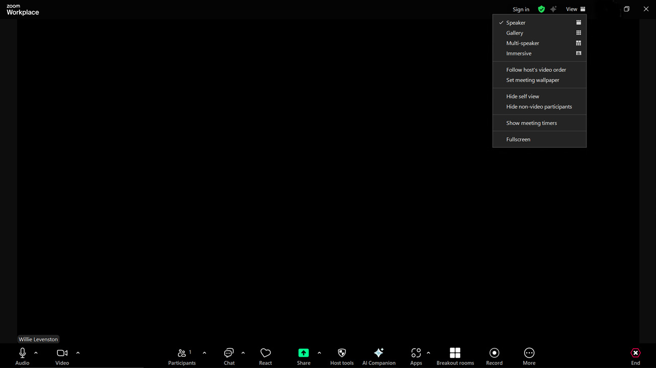

Slide 106
AI Companion
Restore Down
End

Slide 107
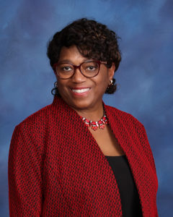
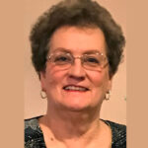
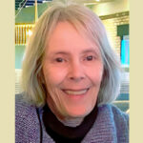
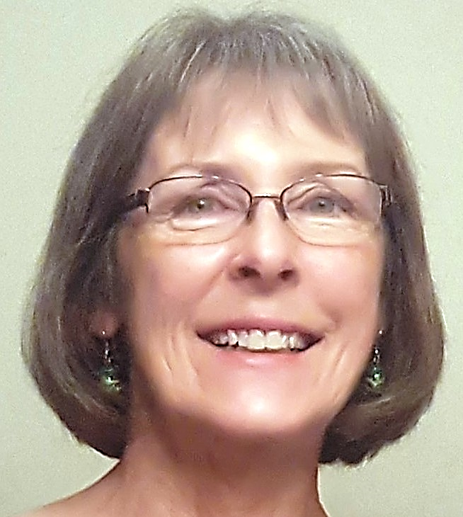
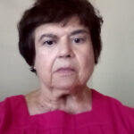
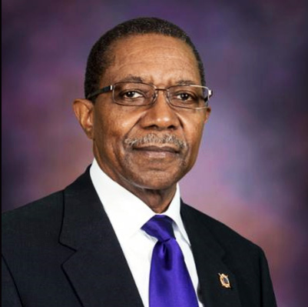
Electronic Communications Team
CHAIR – Constance Bails, Ph.D.
Deborah Fisk
Stan Palen
John Bails
Cindy Graunke
Frances Boatman
Deborah Brown
Willie Levenston
Ellie Long
Fran Sansome
John Bankson
Nancy Palmerino

Slide 108
The End
Thanks for watching
Wednesday June 4 at 2:00 PM

Slide 109
Questions
Wednesday June 4 at 2:00 PM

