Slide 1
Mastering Zoom Etiquette for Effective Communication
VANARFE ELECTRONIC COMMUNICATIONS
Constance T. Bails, Ph.D.
Essential Tips for Professional Virtual Meetings

Slide 2
Overview of Zoom Etiquette
Understanding Zoom etiquette is crucial for maintaining professionalism in virtual meetings.
This presentation covers key aspects such as camera usage, background settings, and communication styles.
We will explore how to engage effectively with participants and manage distractions.
Lastly, we will discuss the importance of follow-ups and feedback in virtual meetings.

Slide 3
Preparing for the Meeting
- Test your technology (audio, video, internet connection).
- Choose a quiet location.
- Ensure good lighting.
- Dress appropriately.

Slide 4
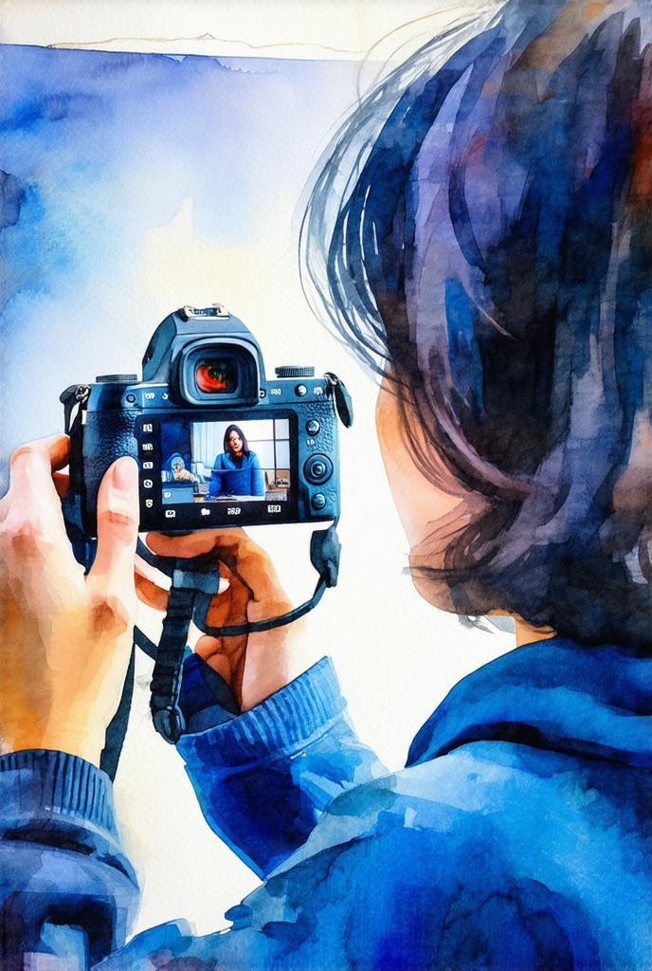
Key Elements of Zoom Etiquette
Understanding Camera and Audio Settings
Proper camera positioning and clear audio are vital for effective communication. Ensure your camera is at eye level and your microphone is functioning well to avoid disruptions.

Slide 5
Joining the Meeting
- Join on time.
- Mute your microphone upon entry.
- Turn on your camera if appropriate.

Slide 6
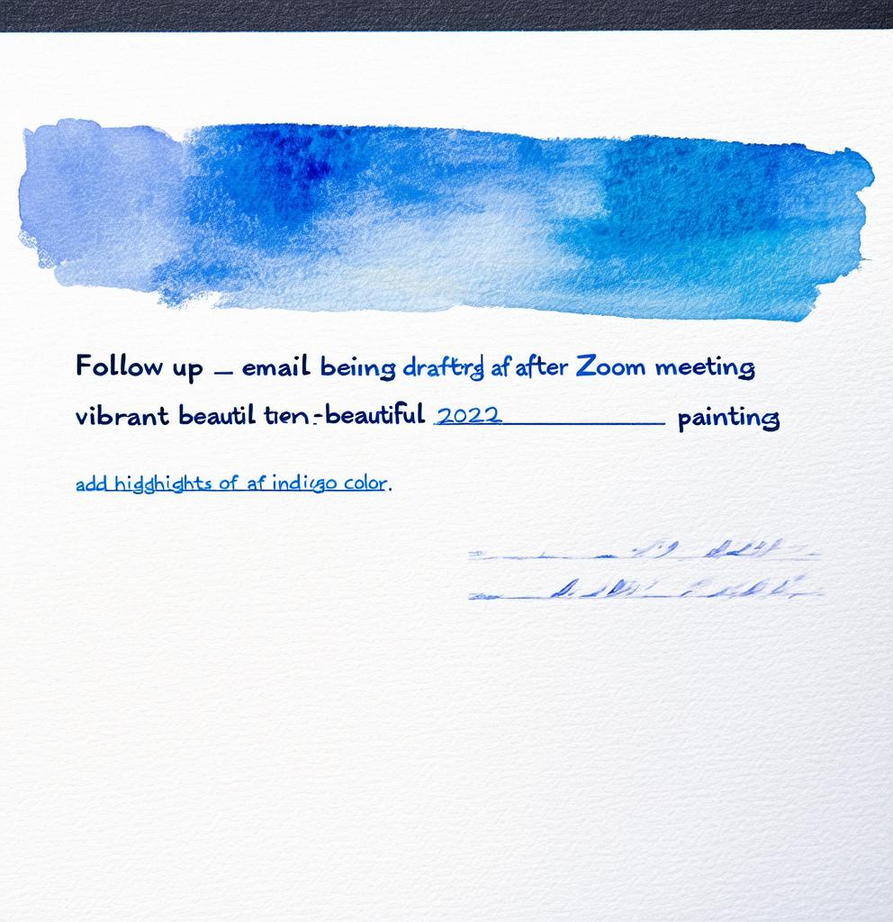
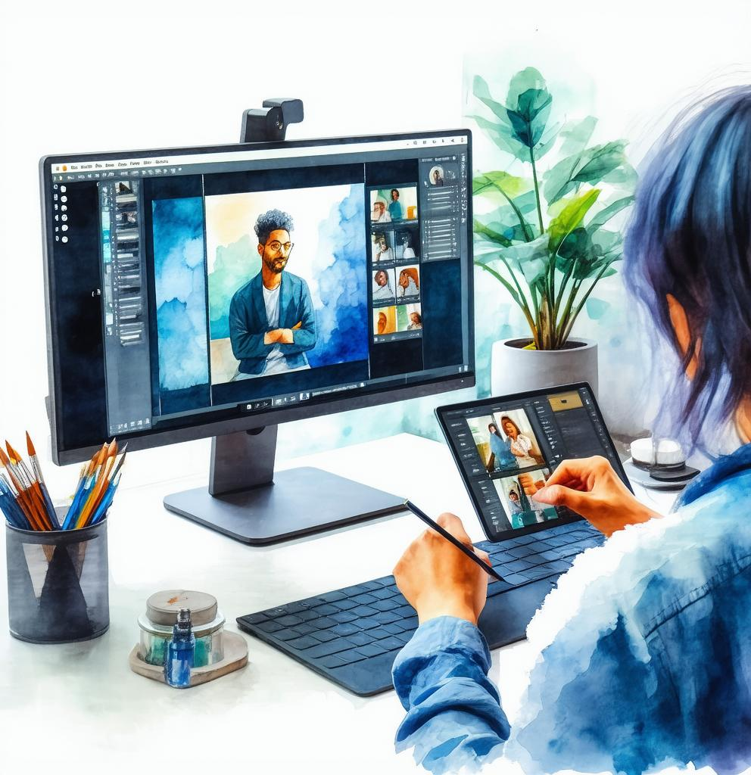
Three Key Points of Zoom Etiquette
1. Be Present and Engaged
2. Set Up a Professional Background
3. Follow Up After Meetings
Actively participate in discussions, maintain eye contact with the camera, and avoid multitasking during meetings.
Choose a clean and uncluttered background to minimize distractions and maintain a professional appearance.
Send follow-up emails summarizing key points discussed and any action items to ensure clarity and accountability.

Slide 7
Professional Mannerisms During Zoom Meetings
- Avoid Eating and Drinking: Eating during a meeting can be distracting and unprofessional.
- Phone Calls: Mute yourself and turn off your camera if you must take a call.
- Avoid Distracting Movements: Refrain from fidgeting or adjusting your appearance.
- Avoid Grooming Behaviors: Avoid actions like picking your nose or adjusting your hair.
- Minimize Background Noise: Stay in a quiet room and keep your microphone muted.
- Be Mindful of Your Facial Expressions: Keep expressions professional and appropriate.

Slide 8
?
Common Questions about Zoom Etiquette
What should I do if I experience technical difficulties during a meeting? Always inform the host and try to resolve the issue quickly without disrupting the flow of the meeting.
!

Slide 9
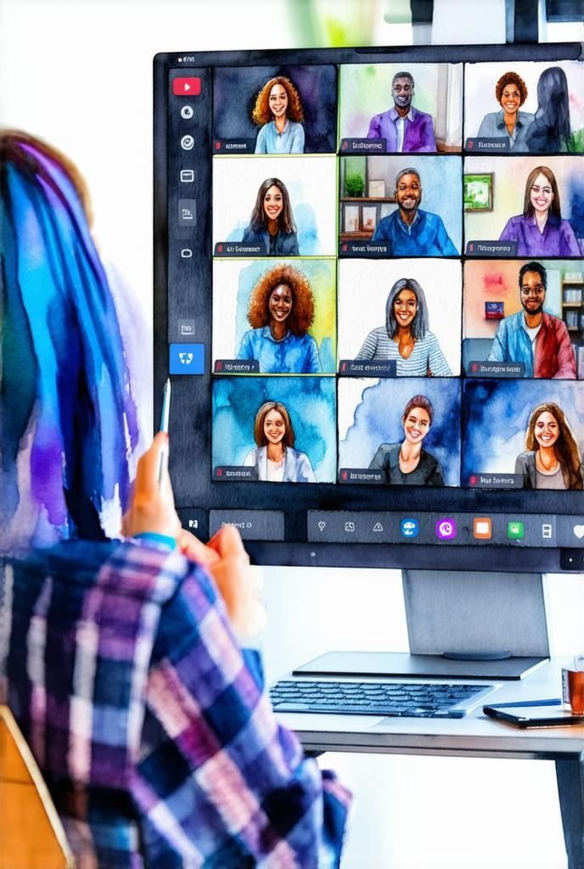
Key Points: Engagement vs. Distraction
Engaging with Participants Effectively
Use direct questions and encourage participation to keep everyone involved and attentive during the meeting.
Managing Distractions During Meetings
Minimize background noise and distractions by muting yourself when not speaking and closing unrelated applications.

Slide 10
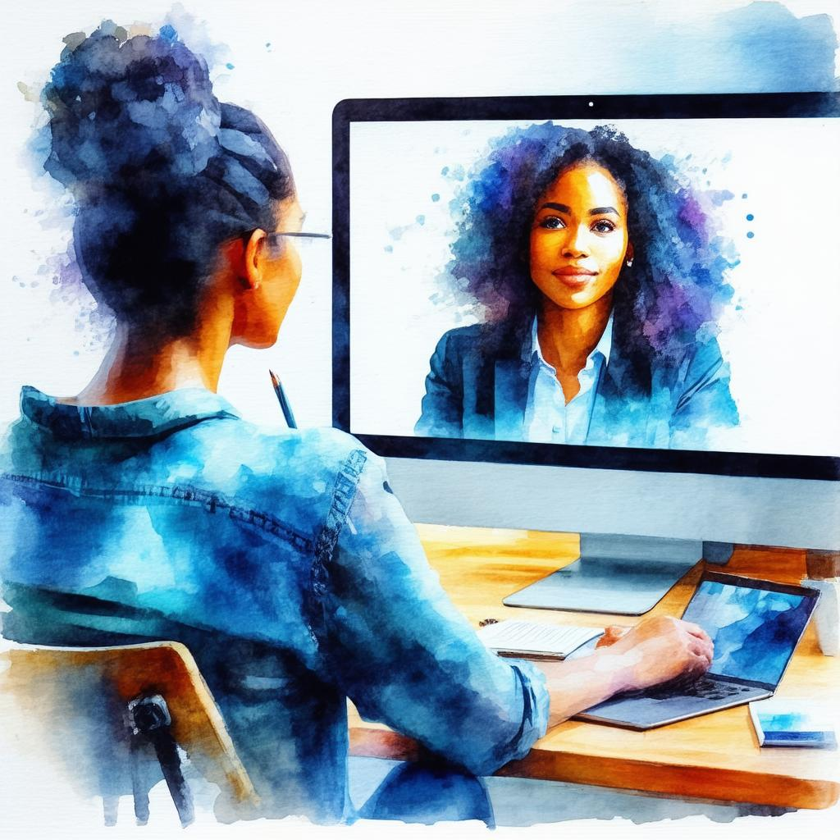
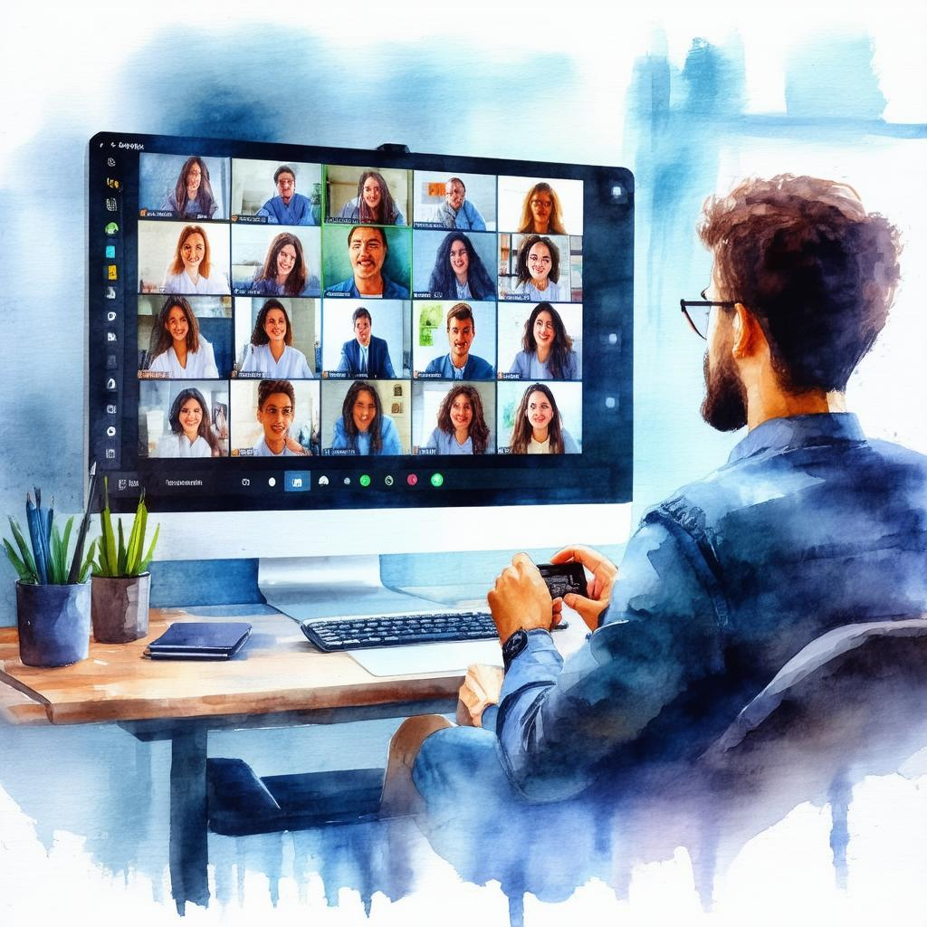
Engagement vs. Distraction in Zoom Meetings
Engagement
Engagement involves active participation and attentiveness, leading to productive discussions.
Distraction
Distraction can derail meetings, causing participants to lose focus and miss key points.

Slide 11
The Importance of Follow-Ups
Follow-ups after meetings are essential for reinforcing discussions and ensuring that everyone is on the same page. They help clarify responsibilities and maintain momentum on projects.

Slide 12
Timeline of Zoom Etiquette Development
The rise of remote work led to an increased focus on Zoom etiquette.
Best practices for virtual meetings were widely shared across industries.
2020
2021
Organizations began implementing formal training on Zoom etiquette.
Zoom etiquette has become a standard part of professional development.
2022
2023

Slide 13
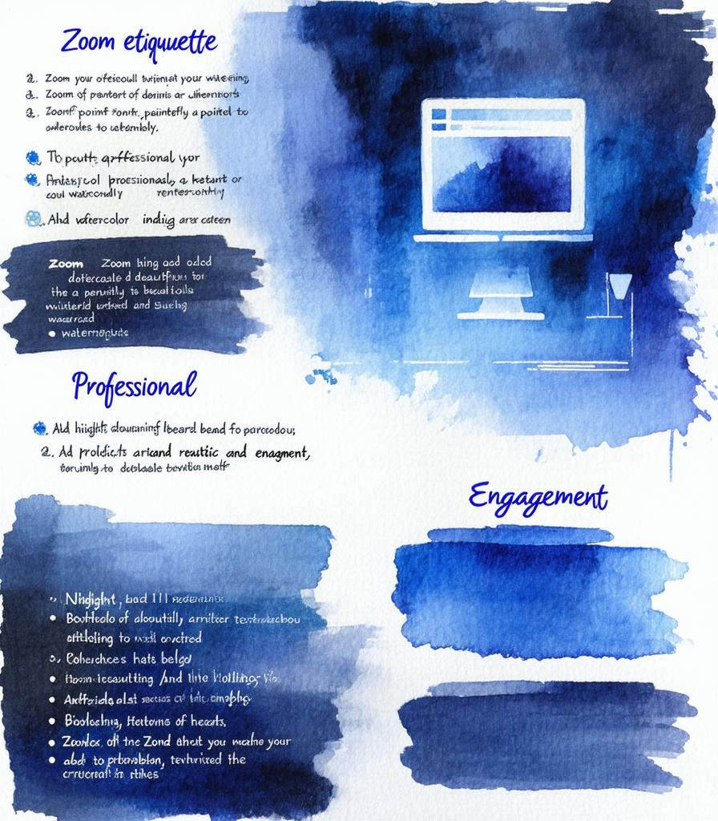
Summary of Zoom Etiquette Best Practices
In summary, mastering Zoom etiquette is essential for effective virtual communication. Key practices include being present, setting up a professional environment, and following up after meetings.
Constance T. Bails, Ph.D.
Electronic Committee, Chair

