Slide 1
2025 FEP
Benefits Summary
For federal employees and their families
Deana Tisdale
Senior Account Consultant
fepblue.org

Slide 2
We have plans designed to fit every need and budget.
FEP
Blue Focus®
FEP
Blue BasicTM
FEP
Blue StandardTM

Slide 3
Quality care in all 50 states
With a large nationwide network of doctors and hospitals, in-network care is never far away:
2 Million+
doctors & hospitals
55,000+
retail pharmacies
Members of all three of our plans have access to the same network* of Preferred doctors and hospitals.
*Members enrolled in the FEP Medicare Prescription Drug Program have a larger pharmacy network.

Slide 4
What’s new for 2025

Slide 5
Telehealth visits
We will cover all your telehealth visits from Teladoc Health® at no out-of-pocket cost to you.

Slide 6
Telehealth services through Teladoc Health
Connect with board-certified doctors by phone or video anytime, anywhere
at no cost to FEP members. Get care for:
General health
Nutritional counseling
Mental health
Global care
Dermatology

Slide 7
Changes to FEP Blue Basic
We updated the copays for:
Specialist visits
Inpatient admissions
Outpatient visits and services
Outpatient visits and services
Preferred brand name drugs (Tier 2)
Specialty drugs (Tiers 4 and 5)
The out-of-pocket maximum has also been updated.

Slide 8
This is not a full list of benefit changes. To view the full list, download the Blue Cross and Blue Shield Service Benefit Plan brochures at fepblue.org/brochure.

Slide 9
Deductibles
FEP Blue Focus
Self Only: $500
Self + One/Self & Family: $1,000
FEP Blue Basic No Deductible
FEP Blue Standard
Self Only: $350
Self + One/Self & Family: $700
Deductibles only apply to certain services.

Slide 10
Out-of-pocket maximum
FEP Blue Focus
Self Only: $9,000
Self + One/Self & Family: $18,000
FEP Blue Basic
Self Only: $7,500
Self + One/Self & Family: $15,000
FEP Blue Standard
Self Only: $6,000
Self + One/Self & Family: $12,000

Slide 11
FEP FEHB
monthly premiums
FEP Blue Focus
Self Only (131): $128.21
Self + One (133): $275.63
Self & Family (132): $303.17
FEP Blue Basic
Self Only (111): $245.18
Self + One (113): $593.97
Self & Family (112): $657.82
FEP Blue Standard
Self Only (104): $378.76
Self + One (106): $832.31
Self & Family (105): $920.07
These rates don’t apply to all enrollees. If you are in a specific enrollment category, please contact the agency that maintains your health benefits enrollment.

Slide 12
FEP PSHB
monthly premiums
FEP Blue Focus
Self Only (35A): $128.21
Self + One (35C): $275.63
Self & Family (35B): $303.17
FEP Blue Basic
Self Only (33A): $247.26
Self + One (33C): $608.81
Self & Family (33B): $688.18
FEP Blue Standard
Self Only (33D): $377.28
Self + One (33F): $840.75
Self & Family (33E): $943.43
These rates don’t apply to all enrollees. If you are in a specific enrollment category, please contact the agency that maintains your health benefits enrollment.

Slide 13
Medicare Reimbursement Account

Slide 14
Medicare Reimbursement Account
Basic Option members who have Medicare Parts A and B can get reimbursed up to $800 for Medicare Part B premiums.

Slide 15
Here’s how it works
Register or log in to your account online or call 1-888-706-2583
Submit your claim online, by mail or by fax to HealthEquity
Provide proof of your Medicare Part B
premium payment
Get reimbursed
$800 by direct deposit or check
Register for an account and learn more at fepblue.org/mra.
We encourage you to consider possible tax implications as part of this program, and to consult your tax, legal or accounting advisors for additional information.

Slide 16
Important things to know
Medicare does not need to be your primary coverage to participate
Anyone on your contract with Medicare Part A and Part B or Medicare Part C can receive this benefit
You must submit a separate claim for each member receiving reimbursement
You can use the funds any way you like—they’re not restricted to qualified medical expenses

Slide 17
Creating your MRA account online
Visit fepblue.org/mra to register.
You will need to provide your 4-digit ID Code.
Your ID Code is a combination of your day of birth (DD) and the last 2 digits of your SSN. For example, if you were born on the 8th day of the month and the last 2 digits of your SSN are 12, your ID Code would be 0812.
After you’ve registered, you can log in and begin filling out the online claim form and uploading your proof documents.
We review most online claims within two business days. We’ll provide your reimbursement once we approve the claim.

Slide 18
IRS documentation requirements
The IRS requires you include the following with your claim to prove you’ve paid your premium:
Date of premium payment
Medicare Part B account holder’s name Name of your insurance carrier (BCBS FEP)
The type of expense (Medicare Part B premium) Proof of payment documentation

Slide 19
Provide proof of premium payment
No matter how you submit your claim form, you must include documents that prove you have paid a Medicare Part B premium.
Examples include:
A Social Security Cost of Living Adjustment (COLA) statement
A canceled check*
A copy of your credit card statement*
A copy of your bank statement*
*If you submit a check, credit card statement or bank statement, you must also submit a Medicare Part B premium bill that matches the paid amount.

Slide 20
Pharmacy programs for active employees
Our traditional pharmacy program is designed to be a convenient way for members to get the prescriptions they need.
Retail Pharmacy Program
FEP Mail Service Pharmacy Program |  | *
FEP Specialty Pharmacy Program
FEP Blue Focus
FEP Blue Basic FEP Blue Standard
*Available if you have Medicare Part B primary.
For pharmacy benefits for members with Medicare, please visit fepblue.org/medicarerx.

Slide 21
Get to know the FEP Medicare Prescription Drug Program
fepblue.org

Slide 22
What is the FEP Medicare Prescription Drug Program?
The FEP Medicare Prescription Drug Program, or MPDP,
is a prescription drug benefit exclusively for Blue Cross and Blue Shield Federal Employee Program (FEP) members with Medicare. It’s part of your Blue Cross and Blue Shield Service Benefit Plan coverage.

Slide 23
Eligibility
You are eligible for MPDP if you are:
An FEP member
Eligible for Medicare Part A
A resident of the U.S. or a U.S. territory

Slide 24
Features of MPDP
With MPDP, you:
Continue to receive the same FEP health plan benefits you’re used to
Have additional approved prescription drugs than the traditional FEP pharmacy benefit Get lower out-of-pocket costs for higher-cost drugs
Have a $2,000 cap on the amount you pay out-of-pocket on prescriptions annually Don’t pay a separate FEP premium for your prescription drug coverage
Depending on your income level, you may need to pay an Income-Related Monthly Adjustment Amount (IRMAA) to Social Security. Learn more at medicare.gov.

Slide 25
Drug tiers
MPDP has four drug tiers:
1
Tier 1:
Generics
2
Tier 2: Preferred brand name
3
Tier 3: Non-preferred brand name
4
Tier 4: Specialty drugs

Slide 26
How to get your prescriptions
You can order prescription refills at one of our 65,000+ in-network retail pharmacies or through the FEP Mail Service Pharmacy Program
(FEP Blue BasicTM and FEP Blue StandardTM only).
This is a larger network than the traditional FEP pharmacy benefit.

Slide 27
What about specialty drugs?
Specialty drugs are tier 4 drugs with MPDP. Depending on how the drug is dispensed, you can buy specialty drugs via retail pharmacies or mail service.

Slide 28
What you’ll pay
MPDP is included as part of your current FEP premium. You will pay your FEP premium plus your Medicare Part B premium if you have Part B.

Slide 29
What is an IRMAA?
If you are above a certain income level, you will pay an Income Related Monthly
Adjustment Amount (IRMAA). Your IRMAA is a cost that’s added to your monthly Medicare Part B and Part D premiums based on your annual income.
Most FEP members will not reach the threshold to pay an IRMAA.
To learn more, visit medicare.gov.

Slide 30
Know if your drug is covered and what it costs
You can use the FEP Prescription Drug Cost Tool to look up your specific drugs and how much they will cost. You can also compare the costs to your current FEP prescription drug benefits.
To use the Drug Cost Tool or to download the full formulary for your plan, visit fepblue.org/medicarerx.

Slide 31
See your current prescription drug costs
If you’re a member and logged in to MyBlue®, you can access a personalized drug cost tool that shows you the cost of your current prescription drugs for your specific plan. Get started at fepblue.org/myblue.

Slide 32
What is an out-of-pocket maximum?
An out-of-pocket maximum is a cap (or maximum) on the amount you’ll pay for your health care costs. In the case of MPDP, it’s a cap on the amount you’ll pay for prescription drugs for the year. Once you reach the maximum for the year, you pay nothing out-of-pocket for your prescriptions for the rest of the year.

Slide 33
What about my overall medical out-of-pocket maximum?
If you’re a member enrolled in the Federal Employees Health Benefits (FEHB) Program, your pharmacy
out-of-pocket maximum will not count toward your overall out-of-pocket maximum.
If you're a Postal Service Health Benefits (PSHB) Program member, your prescription drug out-of-pocket maximum counts toward your overall medical
out-of-pocket maximum.
Since you have Medicare, we waive your medical
out-of-pocket costs, so unless something were to happen where you exhaust your Medicare hospital benefits,
you wouldn’t pay medical out-of-pocket costs anyway.

Slide 34
Annual pharmacy out-of-pocket maximum
$2,000 per member

Slide 35
Medication Therapy Management (MTM) Program
If you have complex prescription drug needs, this program is available to you to get support from a pharmacist. They’ll help ensure you get the most out of your current drug therapy.

Slide 36
Learn more
To learn more about the FEP Medicare Prescription Drug Program, call
1-888-338-7737 (TTY: 711).
Or visit fepblue.org/medicarerx to access more details.

Slide 37
Wellness programs and tools

Slide 38
Who’s eligible
Blue Health Assessment | *
Daily Habits | *
Routine Annual Physical Incentive Program
Pregnancy Care Incentive Program
FEP Blue Focus
FEP Blue Basic
FEP Blue Standard
You must be the contract holder or spouse, 18 or older, to earn incentive rewards.
*FEP Blue Focus members can participate in these programs without earning the reward dollars.

Slide 39
Spending your rewards dollars
Your MyBlue® Wellness Card is a debit card that you can use to pay for qualified medical expenses and select items through the Blue365® Discount Program. You’ll receive your card the first time you complete an eligible activity.
Extra rewards dollars you earn will be automatically added to your card. They don’t expire as long as you stay a member of FEP.

Slide 40
Use on qualified medical expenses
Prescription drugs
Eye exams and eyewear
Acupuncture
Doctor’s office copays
Dental treatments
Lab fees
Visit irs.gov/publications/p502 to see a full list.

Slide 41
Use on non-qualified medical expenses
You can use up to $150 each year on select items available via the Blue365 Discount Program, such as:
Personal care products
Gym discounts
Fitness apparel
And more
Meal plans and subscriptions

Slide 42
Tools and resources

Slide 43
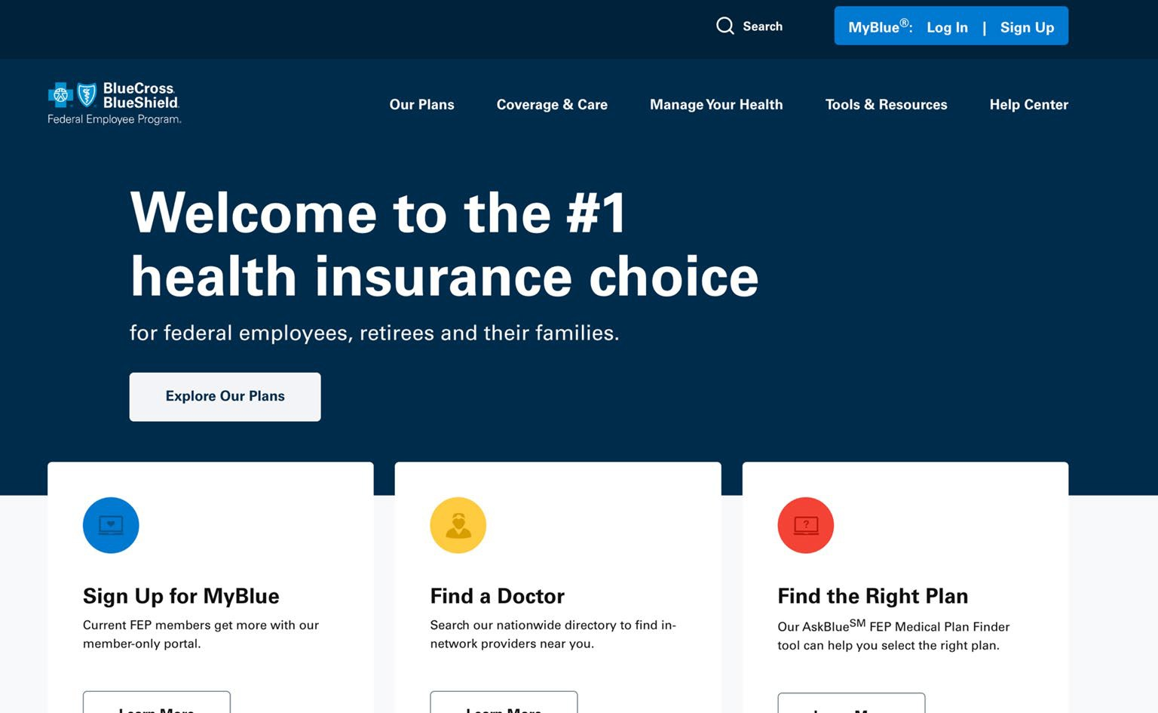
Visit fepblue.org
fepblue.org is our public website where you can learn about everything FEP has to offer.

Slide 44
Get more with MyBlue®
MyBlue is our member-only site
that gives you access to helpful tools and resources, such as a financial dashboard, wellness incentives, digital member ID cards and more.
Visit fepblue.org/signup to get started.

Slide 45
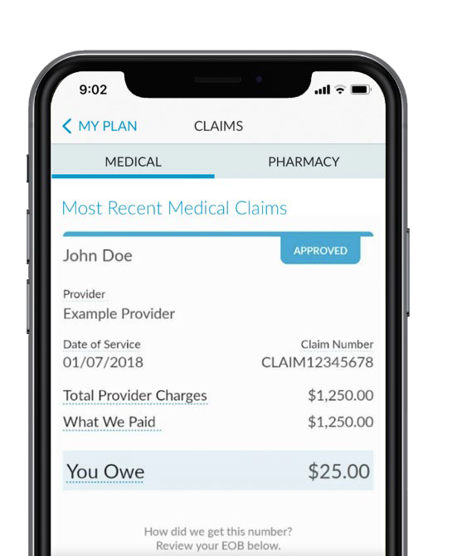
Keep up with your benefits on the go
With the fepblue app, you have access to your benefits in the palm of your hand.
Keep track of out-of-pocket costs Find Preferred providers
Use your digital member ID card
Access the 24/7 Nurse Line and Teladoc Health
You must have a MyBlue® account to access most of the app’s features. Visit the App Store® or
Google Play to download the fepblue app today.
45

Slide 46
BCBS FEP
Dental benefits

Slide 47
Benefits that make you smile
Fully-covered, in-network preventive care, exams, X-rays and up to three dental cleanings a year
No deductible for in-network services
Benefits start right away— there’s no waiting period for in-network coverage
An unlimited annual benefit
for covered in-network services under High Option
Worldwide coverage with all overseas services at the in-network benefit level
Access to 100+ health and wellness discounts with Blue365®
47

Slide 48
2025
premiums

Slide 49
Find your BCBS FEP Dental premium
Premiums are based on where you live. To find yours, check the rating area for your state or ZIP Code and then match it to the appropriate rating area and enrollment type. You can find your rating area by visiting opm.gov.
EXAMPLE
State | First 3 digits of your ZIP Code | Rating Area
MD | 205-212,214,216-217 | 3

Slide 50
2025 High Option premiums
High Option Premiums
Rating Area | Self Only |  | Self + One |  | Self & Family
 | BI-WEEKLY | MONTHLY | BI-WEEKLY | MONTHLY | BI-WEEKLY | MONTHLY
1 | $18.95 | $41.06 | $37.90 | $82.12 | $56.84 | $123.15
2 | $21.23 | $46.00 | $42.46 | $92.00 | $63.69 | $138.00
3 | $23.10 | $50.05 | $46.21 | $100.12 | $69.31 | $150.17
4 | $25.03 | $54.23 | $50.05 | $108.44 | $75.08 | $162.67
5 | $28.01 | $60.69 | $56.02 | $121.38 | $84.03 | $182.07

Slide 51
2025 Standard Option premiums
Standard Option Premiums
Rating Area | Self Only |  | Self + One |  | Self & Family
 | BI-WEEKLY | MONTHLY | BI-WEEKLY | MONTHLY | BI-WEEKLY | MONTHLY
1 | $10.19 | $22.08 | $20.39 | $44.18 | $30.58 | $66.26
2 | $11.17 | $24.20 | $22.33 | $48.38 | $33.50 | $72.58
3 | $12.69 | $27.50 | $25.38 | $54.99 | $38.07 | $82.49
4 | $13.70 | $29.68 | $27.40 | $59.37 | $41.10 | $89.05
5 | $15.12 | $32.76 | $30.24 | $65.52 | $45.37 | $98.30

Slide 52
BCBS FEP
Vision benefits

Slide 53
BCBS FEP Vision benefits
Benefit | High Option | Standard Option
Vision Care Exam | You pay nothing for one exam per year.¹ | You pay nothing for one exam per year.¹
Retinal Imaging | You pay a $29 copay. | You pay a $29 copay.
Eyeglass Lenses | You pay nothing for one pair per year. | You pay a $10 copay for one pair per year.
BCBS Exclusive Collection Frames | You pay nothing for one pair per year. | You pay nothing for one pair per year.
Frame Allowance (in lieu of Exclusive Collection Frames) | You receive a $200 frame allowance toward any other provider-supplied frames, plus 20% off charges over $200.² or | You receive a $140 frame allowance toward any other provider-supplied frames, plus 20% off charges over $140.² or
 | You receive a $250 frame allowance at MyEyeDr. | You receive a $190 frame allowance at MyEyeDr.
Contact Lenses (in lieu of eyeglasses) | You receive $150 per calendar year toward contact lenses, plus 15% off charges over $150.² | You receive $140 per calendar year toward contact lenses, plus 15% off charges over $140.²
Contact Lens Evaluation | You pay nothing for evaluation, fitting and follow-up for non-specialty lenses, plus 15% off charges over $60 for specialty contacts. | You pay a $55 copay for evaluation, fitting and follow-up for non-specialty lenses.
¹Two vision care exams per year for children 13 and under.
²Retail locations and online providers are not required to provide this discount.
53

Slide 54
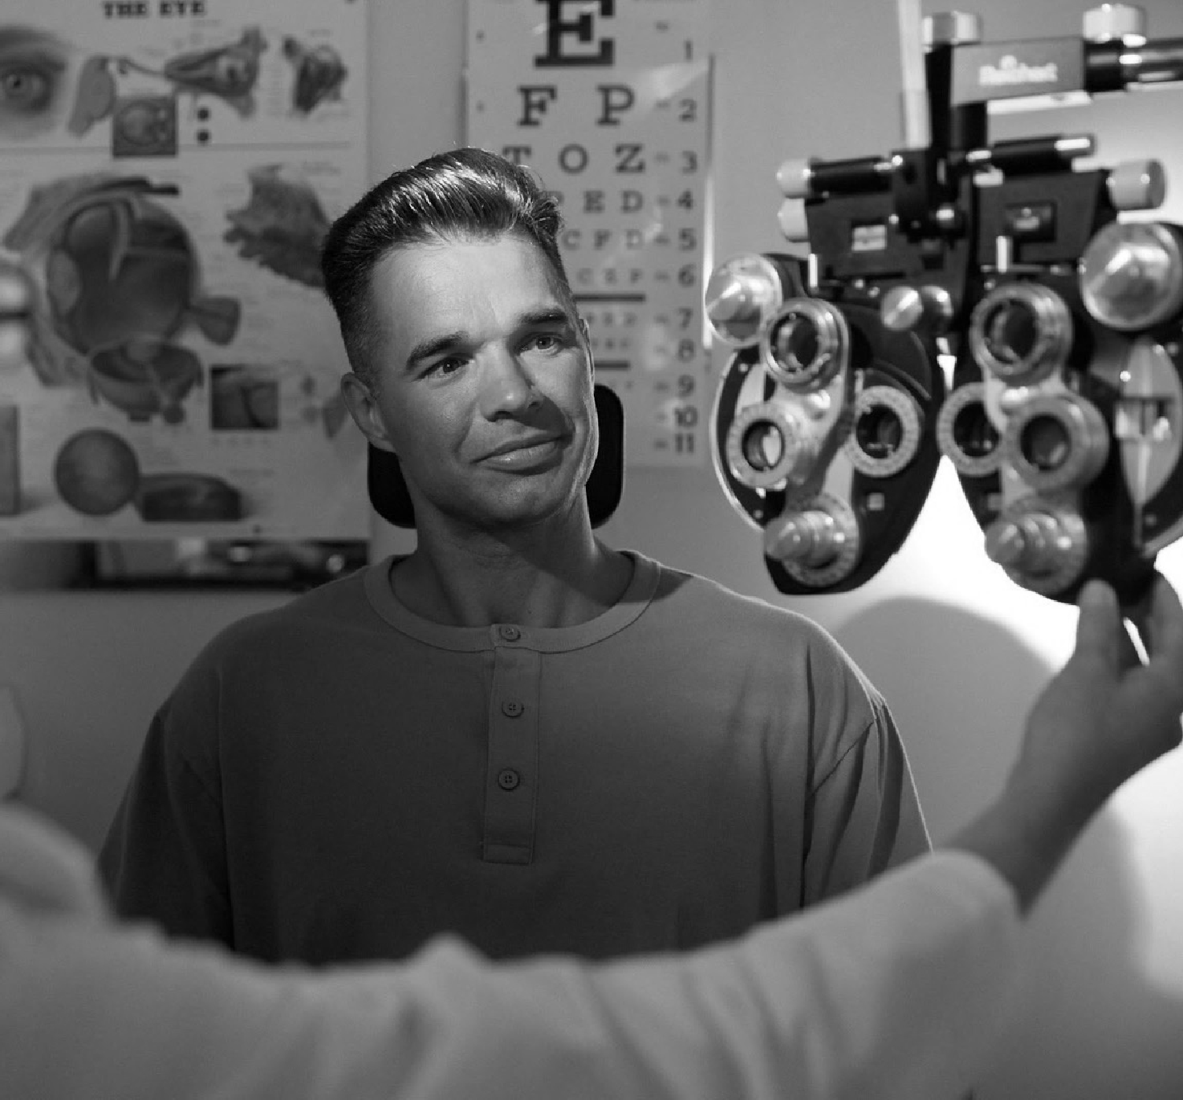
2025
premiums
54

Slide 55
2025 BCBS FEP Vision premiums
 | High Option |  | Standard Option
 | BI-WEEKLY | MONTHLY | BI-WEEKLY | MONTHLY
Self Only | $5.66 | $12.26 | $3.56 | $7.71
Self + One | $11.31 | $24.51 | $7.12 | $15.43
Self & Family | $16.97 | $36.77 | $10.68 | $23.14
55

Slide 56
The CareFirst Difference
Federal Employee Health Benefits Program
Postal Service Health Benefits Program

Slide 57
CareFirst Difference
1 IN 2 AMERICANS are
covered by Blue regionally
99% of physicians are in- network regionally
100% of hospitals are in- network regionally
97% of claims are paid in- network regionally
57

Slide 58
Our Product Options
BlueChoice Advantage HDHP (HSA/HRA
compatible)
Blue Value Plus
Standard BlueChoice
PSHBP does NOT have Standard BlueChoice as a plan option.
58

Slide 59
What’s New for 2025 ?
BlueChoice Advantage High Deductible Health Plan
Out-of-Pocket Maximum is changing to $5,500 for Self Only and
$11,000 for Self + one and Self and Family
Deductible changes to $1,650 for Self Only and $3,300 for Self + one and Self and Family
Standard BlueChoice Option
Out of Pocket Maximum is changing to $5,500 for Self Only and
$11,000 for Self + one and Self and Family
Updated Copays for:
Primary Care Physician (PCP) - $25
Specialist Copay - $50
Prescription Drug copays for a 34-day supply:
Tier 1 - $10
Tier 2 - $75
Tier 3 - $125
Tier 4 - $125
Tier 5 - $175
Blue Value Plus
Out-of-Pocket Maximum is changing to $6,500 for Self Only and
$13,000 for Self + one and Self and Family
CareFirst BlueCross BlueShield
Proprietary and Confidential 59

Slide 60
FEHBP Monthly Premiums
BlueChoice Advantage HDHP (HSA/HRA
compatible)
Self Only (B61): $187.07
Self + One (B63): $374.15
Self & Family (B62): $444.49
Self Only (B64): $193.76
Self + One (B66): $387.52
Self & Family (B65): $460.36
Blue Value Plus
Self Only (2G4): $525.31
Self + One (2G6): $933.97
Self & Family (2G5): $1235.13
Standard BlueChoice

Slide 61
PSHBP Monthly Premiums
BlueChoice Advantage HDHP (HSA/HRA
compatible)
Self Only (K4A): $181.63
Self + One (K4B): $363.25
Self & Family (K4C): $431.54
Self Only (K4D): $193.76
Self + One (K4E): $387.52
Self & Family (K4F): $460.36
Blue Value Plus

