Slide 1
VFN Legislative Program 2023 VFN Conference April 2-5, 2023 Gaston Gianni VFN National Legislative Chair

Slide 2
VFN National Legislative Report
Overview
Mission of the Committee
VFN National Team
SUPPORT The NARFE PAC to Table out front!!!

Slide 3
OVERVIEW
2022 VA Election Results
VA Congressional Delegation—118th
VFN Advocacy Mission
SLLs-CDLs—Building Relationships
VFN National Legislation Team
VFN Team Members
VA Election Impacts on VFN
NARFE Legislative Priorities—118th
NARFE’s Advocacy Positions—118th
2021-2022 PAC Funds
Questions

Slide 4
VFN ADVOCACY MISSION
NARFE Advocacy in Virginia
Build Congressional Relationships
Build NARFE Area VP Relationships
Build Relationship with Chapters and Chapter National Legislative Chairs
Encourage NARFE Members to contact Congressional Representatives
Assist with NARFE Political Action Funds (PAC) contribution decisions

Slide 5
VFN National Legislative Team 118th Congress
SL Charles Kawecki, Shenandoah 2358—Sen. Mark Warner
SL Eddie Eitches, McLean Great Falls 489—Sen. Tim Kaine
1st CDL—Marilyn Riddle, Williamsburg 685--Rep. Rob Wittman
2nd CDL—Ray Orland, Suffolk 1743-Rep Jen Kiggans
3rd CDL –Maggie Keator, Peninsula 682, Rep. Bobby Scott
4th CDL Debbie Fisk, Midlothian 2265, Rep. Donald McEachin
5th CDL Joanne Hirsch, Charlottesville 0135—Rep. Bob Good
6th CDL Dr. Leon Vinci Roanoke 111,Rep. Ben Cline
7th CDL Bob Martin ,Fredericksburg 90—Rep. Abigail Spanberger
8th CDL Thomas Hart, Fairfax 737--Rep. Don Beyer
9th CDL—Frances Boatman, Roanoke 111--Rep. Morgan Griffith
10th CDL Dennis Freeman Fairfax 737—Rep. Jenifer Wexton
11th CDL Judy Thorne, Dulles 1241—Rep. Gerald Connolly

Slide 6
TO BE CONTINUED
Tuesday April 4, 3pm to 4pm
Room 104
Hope to see you there!!
Don’t forget to stop by the PAC Table!!!!

Slide 7
VFN Legislative Program 2023 VFN Conference April 2-5, 2023 Gaston Gianni VFN National Legislative Chair

Slide 8
OVERVIEW
2022 VA Election Results
VA Congressional Delegation—118th
VFN Advocacy Mission
SLLs-CDLs—Building Relationships
VFN National Legislation Team
VFN Team Members
VA Election Impacts on VFN
NARFE Legislative Priorities—118th
NARFE’s Advocacy Positions—118th
2021-2022 PAC Funds
Questions

Slide 9
VA Election Results
Before Elections—7 Democrats
4 Republicans
After Elections -----6 Democrats
5 Republicans
10 returning members for the 117th Congress
2 new members: for CD 2—Jen Kiggans (R)
Replaces Elaine Luria (D): for CD 4—Jennifer McCellan-- Replaces Congressman McEachin

Slide 10
VA CONGRESSIONAL DELEGATION—118th
Sen Mark Warner(D)
Sen Tim Kane (D)
1st Rob Wittman (R)
2nd Jen Kiggans (R)
3rd Bobby Scott (D)
4th Jennifer McClellan (D)
5th Robert Good (R)
6th Ben Cline (R)
7th Abigail Spanberger (D)
8th Don Beyer (D)
9th Morgan Griffith (R)
10th Jennifer Wexton (D)
11th Gerry Connolly (D)
8 Democrats, 5 Republicans

Slide 11
VFN ADVOCACY MISSION
NARFE Advocacy in Virginia
Build Congressional Relationships
Build NARFE Area VP Relationships
Build Relationship with Chapters and Chapter National Legislative Chairs
Encourage NARFE Members to contact Congressional Representatives
Assist with NARFE Political Action Funds (PAC) contribution decisions

Slide 12
SLLs-CDLs– Building Relationships
Congressional
NARFE Focal Contact Person
Get to Know Staff
Meet the Congressional Representative
Inform of NARFE Top Issues
AVPs
Keep in the Communication Loop
Identify chapters in Congressional District
Chapters and Chapter Legislative Chairs
Establish contact with Chapters in District
Encourage members to contact Congressional Reps.

Slide 13
VIRGINA FEDERATION NL TEAM
Chair (Sits on the VFN Board)
2 Senatorial Legislative Leaders (SLLs)
11 Congressional District Leaders
(One for each of Virginia’s 11 Congressional Districts)

Slide 14
VFN National Legislative Team 118th Congress
SL Charles Kawecki, Shenandoah 2358—Sen. Mark Warner
SL Eddie Eitches, McLean Great Falls 489—Sen. Tim Kaine
1st CDL—Marilyn Riddle, Williamsburg 685--Rep. Rob Wittman
2nd CDL—Ray Orland, Suffolk 1743-Rep Jen Kiggans
3rd CDL –Maggie Keator, Peninsula 682, Rep. Bobby Scott
4th CDL Debbie Fisk, Midlothian 2265, Rep. Donald McEachin
5th CDL Joanne Hirsch, Charlottesville 0135—Rep. Bob Good
6th CDL Dr. Leon Vinci Roanoke 111,Rep. Ben Cline
7th CDL Bob Martin ,Fredericksburg 90—Rep. Abigail Spanberger
8th CDL Thomas Hart, Fairfax 737--Rep. Don Beyer
9th CDL—Frances Boatman, Roanoke 111--Rep. Morgan Griffith
10th CDL Dennis Freeman Fairfax 737—Rep. Jenifer Wexton
11th CDL Judy Thorne, Dulles 1241—Rep. Gerald Connolly

Slide 15
Impact on of Elections on VFN
Redistricting of Congressional Districts
Some impact on VFN National Legislative Team
Congressional District Leaders MUST resided in the CD they represent.
2021-2022 NARFE Legislative Agenda Remains ended with 117th Congress
2023-2024 NARFE Legislative Agenda Starts in the New Congress
Needed to reassign VNF CDL Team according to their district
Congressional Distracts impacted—6 Districts
Senator Leader for Senator Warner
Notes:
Redistricting will have some impact on VFN National Legislative Team

Slide 16
NARFE Legislative Priorities 117th Congress
Support Market Rate Increases to Pay
Oppose Compensation Cuts
Support Reform or Repeal WEP & GPO
Support Efforts to Revitalize Workforce
Support More Accurate COLAs
Ensure Postal Reforms Protects Retiree Health Benefits
Oppose any cuts to earned Federal Retirement and Health Benefits
Support COVID-19 Relief Provisions for Federal Community

Slide 17
NARFE’s Advocacy Positions 118th
Retirement issues
Social Security
Pay and Workforce Policies
Health Care—FHEB and Medicare,
and Long-Term Care
https://www.narfe.org/wpcontent/uploads/
LEG CON 23 Legislative Training Conference—June 20-22, 2023
June 20-June 22 (Lobby Day June 22)

Slide 18
NARFE Legislative Priorities 118th Congress
WEP/GPO House 82 (same as last time)
Rep. Graves, Garret [R-LA)
Senate 597 Senator Sherrod Brown (D-OH)
As of March 29, H.R. 82 has 207 cosponsors and S. 597 has 37. None form Virginia!!!
Virginia has 6 cosponsors so far—Spanberger, Wexton, Connolly, Wittman, Scott, & Beyer
Last year we had 8 of 11 VA representatives as cosponsors

Slide 19
NARFE 118th Continued (page 2)
Saving the Civil Service Act, H.R. 1002/S. 399 (prevent Schedule F type employees)
Gerry Connolly, D-VA, and Senator Tim Kaine, D-VA, introduced the Saving the Civil Service Act (H.R. 1002/S. 399) in the House and Senate
Comprehensive Paid Leave for Federal Employees Act, H.R. 856/S. 274
introduced in the House by Rep. Don Beyer Jr. (D-VA) in the Senate by Sen. Brian Schatz (D-HI)

Slide 20
NARFE 118th Continued (page 3)
Chance to Compete Act of 2023, H.R. 159, The bill which was sponsored by Rep. Virginia Foxx, R-NC, had strong bipartisan support.
House unanimously voted for an passed the Chance to Compete Act of 2023, H.R. 159/S. 59 422-2.

Slide 21
NARFE -PAC
What is NARFE-PAC?
Why is it important?
How does it work?
How does it affect me?
Notes:
First up, is educating members about NARFE-PAC.
When talking to NARFE members, I would assume many don’t fully understand what NARFE-PAC is and how it’s separate from NARFE. It’s certainly confusing, which is why educating members is so important. When talking about PAC, explain NARFE-PAC, what it is, why it’s important, how it works and how it affects them.
Specifically, highlight that PAC is a separate, segregated fund of NARFE, that it exists to elect fed-friendly lawmakers and build relationships with them to protect your benefits, it uses a consultative process for disbursement decisions which relies on local input. Also let members know that NARFE-PAC is a critical part of our advocacy efforts.
People want to understand how NARFE-PAC relates to them. A lot of the information in my PAC breakout presentation may be helpful for educating members and providing that connection.

Slide 22
NARFE PAC Process
PAC Chairs
Share Information
Coordinate Local Fundraisers
Solicit Contributions
Educate Members
Provide Recommendations
Notes:
Now I want to talk about you, our NARFE-PAC leaders. First, thank you all for taking on this important position and for all that you do for NARFE and NARFE-PAC.
NARFE-PAC relies on it’s leaders. Without you, NARFE-PAC is limited in it’s ability to grow NARFE’s political influence.
As a leader it’s your responsibility to educate members about NARFE-PAC, solicit contributions, provide recommendation and local feedback, lead the local fundraiser process and inform members about NARFE-PAC progress.
While we do some of these things at the national level, it’s critical that we have leaders on the ground echoing these efforts. And unlike us at Headquarters, you interact with members face to face more often, a unique opportunity to communicate what NARFE-PAC is all about.
I’m going to go over each of these responsibilities.

Slide 23
Top 5 Reasons to Give to NARFE-PAC
Notes:
Now, let’s cover some of the materials that will aid in your fundraising.
Here is the top 5 reasons to give document. This and the other documents I’m about to discuss are available on the NARFE-PAC page of NARFE’s website.
The top 5 reasons has been given a new design and contains some of the most persuasive reasons to give to NARFE-PAC.
There are many ways to use this document. You can verbally share the reasons in your own pitch for NARFE-PAC, you can print it and hand it out/or insert it in a folder for members at a federation/chapter meeting or event or use the reasons in a newsletter. Use it in whatever way you think will be most effective with your members.

Slide 24
Provide Recommendations
Receive candidate request
Federation recommendation
NARFE-PAC Board makes final decision
Notes:
As a leader who has had some contact with campaigns, you may hear about a fundraiser from the campaign. If you do, forward the invitation to Advocacy Department staff so they can start the consultative process.
The consultative process requires PAC leaders to have and use email. All recommendations must be received via email, to keep a written record of all recommendations.
The federation PAC coordinator and federation president will be emailed by advocacy staff requesting a recommendation on a candidate. Leaders should consult with others in the state, including chapter NARFE-PAC chairs, CDLs (if applicable), federation board (if applicable) and other members within the district to reach a consensus recommendation. The recommendation should be based on whether the candidate is supportive of NARFE issues and what the relationship is like between them and NARFE members. It should not be based on any issues not relevant to NARFE’s mission.
Federation PAC coordinators are asked to provide written recommendations within two weeks. Because of the tight turnaround on fundraisers, it may be necessary to discuss candidates before an official request comes from the advocacy staff.
Make sure you ask those in the congressional district about the recommendation. From experience, there have been instances where PAC and other leaders in congressional districts did not know that a recommendation was requested. Communication is key and keeps people engaged and informed of the process.
When it comes to making a recommendation:
Recommendation should be based on:
Candidate’s interactions with NARFE members
Candidate’s outreach/relationship with local chapters/federation. Please tell us what we may not know.
Recommendations should not be based on:
Personal political biases
Non-NARFE related issues
Review the Consultative Process:
Headquarters receives a candidate request.
We then ask for a recommendation
The recommendation is provided to the NARFE-PAC Board
NARFE-PAC Board makes the final PAC decision
HQ emails a copy of the check that is sent
Leaders disburse that info to the federation members

Slide 25
Factors Considered
Support of NARFE issues
Influence of legislator
Federation recommendation
Overall NARFE-PAC budget
Competitiveness of race
Relationship with NARFE and its members
Notes:
Here are some of the factors taken into consideration by the PAC Board when deciding on whether to disburse funds.
The top factor is the candidate’s support of NARFE issues. If the candidate is currently in office, the Board looks at his/her NARFE voting record, bill cosponsorships, letter signiatures, caucuses and committee assignments.
If the candidate is not in office, NARFE sends him/her a candidate questionnaire to gauge support of the federal community.
Emphasis: These are only for new candidates
Does the candidate have a relationship with NARFE and its members such that s/he has made themselves available to listen to our concerns? If they aren’t with us all the time, is the candidate willing to move in our direction or work with us on some issues?
The Board also considers the federation recommendation received from the state, which should include how accessible the candidate has been to NARFE members.
Other factors considered include the influence of the legislator, like a particular committee assignment or party leadership position that can influence the legislative agenda, the competitiveness of the race and the overall PAC budget.
The Board must determine in which races NARFE-PAC dollars can make a difference in electing fed-friendly lawmakers and building strong relationships. The NARFE-PAC budget takes this into account.

Slide 26
NARFE-PAC Goals 2023-2024
Raise: $1.6 million
Disburse: $1.2 million
Attend: 125 in-district fundraisers
Notes:
Let’s now go over the goals for the 2021-2022 cycle. This will put everything in focus and give us something to work towards.
During this cycle, NARFE-PAC aims to:
Raise $1.85 million in contributions
Disburse $1.35 million for political purposes
Send NARFE members to 120 in-district fundraisers
These are ambitious goals, but they will allow NARFE-PAC to maintain its upward trajectory. Reaching these goals will help grow NARFE’s political relevancy, strengthen support for our allies, and continue to foster and begin new relationships with candidates and members of Congress.

Slide 27
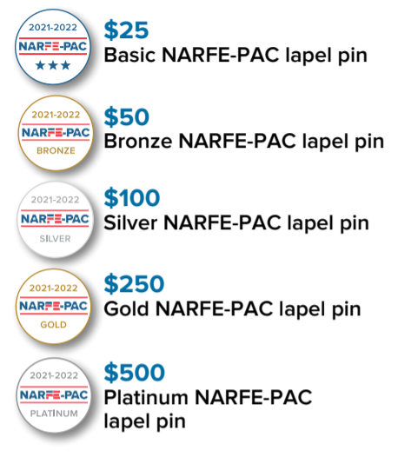
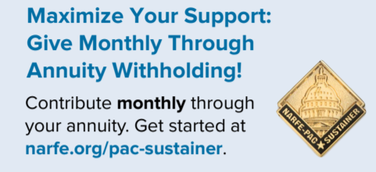
NARFE-PAC Giving Levels
Notes:
As NARFE-PAC leaders, members may have some questions about the giving levels, along with the pins and new incentive item.
These contribution totals are cumulative for the 2020-2021 election cycle. So, the giving level you fall into takes into account the sum of all NARFE-PAC contributions you make in the two-year cycle.
The Basic lapel pin is for contributors of $25 - $49.
The Bronze lapel pin is for contributors of $50 - $99.
Contributors who make a one-time contribution of $100 - $249 will receive the Silver lapel pin.
The gold level is for contributions of $250 or more and receive a silver lapel pin.
We also have the platinum level which is for contributions of $500 or more, who receive a platinum lapel pin.
Our monthly sustainer program is the most important NARFE-PAC program. This allows you to contribute a set amount of at least $10 each month automatically via annuity withholding, which I'll discuss more on the next slide, or a credit card.
As a NARFE-PAC Sustainer, you will receive a Sustainer lapel pin.

Slide 28
Become a NARFE-PAC Sustainer!
Become a NARFE-PAC Sustainer!
Sustainer: $10+ per month via annuity withholding or credit card
Maximize your support of NARFE-PAC by making automatic, monthly contributions!
Notes:
The sustainer program is arguably the most important program in NARFE-PAC. It allows you to contribute a set amount of at least $10 each month automatically via annuity withholding or credit card.
Signing up as a NARFE-PAC Sustainer allows members to maximize their support of NARFE-PAC. Sustainers help streamline fundraising efforts and continually grow NARFE’s political influence. From a budgeting perspective, sustainers provide NARFE-PAC with a steady stream of funds and allow NARFE-PAC to better plan contributions.
If you have members who are interested in becoming a sustainer, pitch annuity withholding or have them fill out a contribution form and check the sustainer box. We’ll set up a monthly charge on their credit card. You can direct any questions about the sustainer program from members to me.

Slide 29
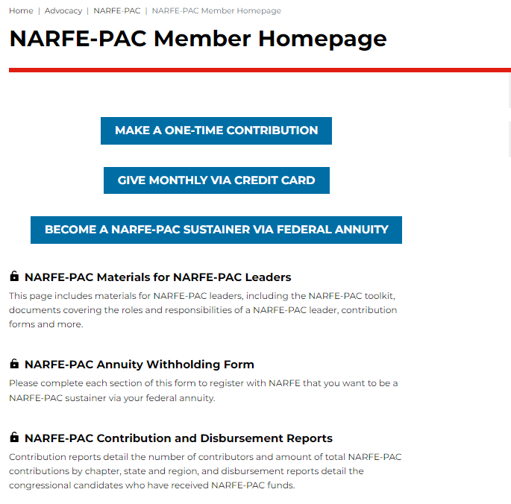
Learn More About NARFE-PAC
NARFE-PAC Website
All PAC materials
PAC Toolkit
Quarterly contribution and disbursement data
Monthly NARFE-PAC newsletter
NARFE-PAC Month Presentation
Notes:
There are also other ways to learn more about NARFE-PAC.
You can find most of the materials on the NARFE-PAC website, which can be found by going to www.narfe.org, hovering over Advocacy at the top of the page and then selecting NARFE-PAC.
On that page you will find all of the NARFE-PAC materials, your toolkit and the quarterly contribution and disbursement data.
The Advocacy Department also sends monthly newsletters to our PAC leaders with helpful information that can be shared with your members.
We also put on webinars from time to time as well. Those can be useful and provide a time to ask specific questions about NARFE-PAC.
And of course, you can always contact me or the advocacy department.

Slide 30
Dos and Don’ts
Do:
Raise NARFE-PAC funds at every chapter and federation meeting
Tell members why NARFE-PAC is important
Explain the giving levels and incentives
Have incentives and promotional materials on hand
Remember that only NARFE members can contribute to NARFE-PAC
Notes:
Now I want to quickly go over some dos and don’ts as a NARFE-PAC leader.
Do
Raise NARFE-PAC funds at every chapter and federation meeting
Tell members why NARFE-PAC is important
Explain the giving levels, incentives
Ask us for incentives and promotional materials to have on hand
Remember that only NARFE members can contribute to NARFE-PAC

Slide 31
Dos and Don’ts
Don’t:
Talk about NARFE-PAC in a congressional office
- OK at fundraising events
Suggest a quid pro quo of PAC funds for official acts
Use chapter funds to contribute to NARFE-PAC
Forget that contributions to NARFE-PAC are not tax-deductible
Notes:
Don’t
Talk about NARFE-PAC in a congressional office
OK at fundraising events
In fact, don’t talk about anything related to the campaign or possibly volunteering to the campaign. Stick to NARFE issues.
Suggest a quid pro quo of PAC funds for official acts (votes, bill sponsorships etc.)
This is illegal, could constitute a bribe
Use chapter funds to contribute to NARFE-PAC
Forget that contributions to NARFE-PAC are not tax deductible

Slide 32
VFN PAC 2021-2022 NUMBERS (117th)
TOTAL VA PAC COLLECTIONS
$145,602 Total collected
1342 Total Members
38-Total Sustainers
TOTAL DISTRIBUTED: $104,500
$64,500 to Members (8 of 11)
$40,000 to Member PACs

Slide 33
VFN 2021-2022 PAC Contributions
TOTAL--$145,602
CHAPTERS--$64,346
VA NATIONAL Members--$49,597
NUMBER OF CONTRIBUTERS--1342
CHAPTERS—698
VA NATIONAL—644
Number of Sustainers—38
Chapters—33
VA National--5

Slide 34
Top 5 VFN Chapters
#1 Arlington 007--$7,191, 49 Contributors
#2 Annandale 1159-- $7,144, 61 Contributors
#3 SPRINGFIELD 893--$6,084, 70 Contributors
#4 Fairfax 737-- $4,687, 44 Contributors
Woodbridge 1270--$4,455, 33 Contributors
.

Slide 35
2021-2022 PAC Distributions in VA
A total of $64,500 was distributed to individual members of the VA Congressional Delegation
Wittman 01 rob Wittman $5,000
Virginia 02 Elaine Luria D $10,000
Virginia 03 Bobby Scott D $5,000
Virginia 04 Don McEachin D $4,500
Virginia 07 Abigail Spanberger D $10,000
Virginia 08 Don Beyer D $10,000
Virginia 10 Jennifer Wexton D $10,000
Virginia 11 Gerry Connolly D $10,000
In addition, a total of $40,000 ($10,000 each) was distributed to the Leadership PAC of Senators Kaine, Warner and Congressmen Beyer and Connolly.

Slide 36
NARFE ADVOCACY HELP
NARFE WEB SITE: EXCELLENT RESOURCE!!
National Legislative Action Center (Letters)
Legislative Hotline (Messages)
Issue Briefs and Fact Sheets
Advocacy Webinars
Grassroots (Tool– How To)
Grassroots Advocacy Month
PAC Information
WWW: NARFE.ORG/legislation/

Slide 37
QUESTIONS?
What have I missed?
What other issues are on your mind?
What other type of Training would you like the VFN to sponsor?

Slide 38
CONTACT INFORMATION
Email: advocacy@narfe.org
Gastongianni@aol.com
Contribute at:
www.narfe.org/narfe-pac/

